Slide 1
Year 7
Parent Welcome
2025

Slide 2
Year 7 Choir

Slide 3
Drama performance inspired by
The Lizzie and Belle Mysteries

Slide 4
Agenda
Ethos and vision
Contacting school
Personal development and co-curricular opportunities
Antibullying
Attendance and behaviour
Equipment, uniform cards, phone pouches
Curriculum and assessment/banding
Reading and homework

Slide 5
Mr Crossley
Headteacher

Slide 6

Core Purpose
Raising achievement of all students

Slide 7
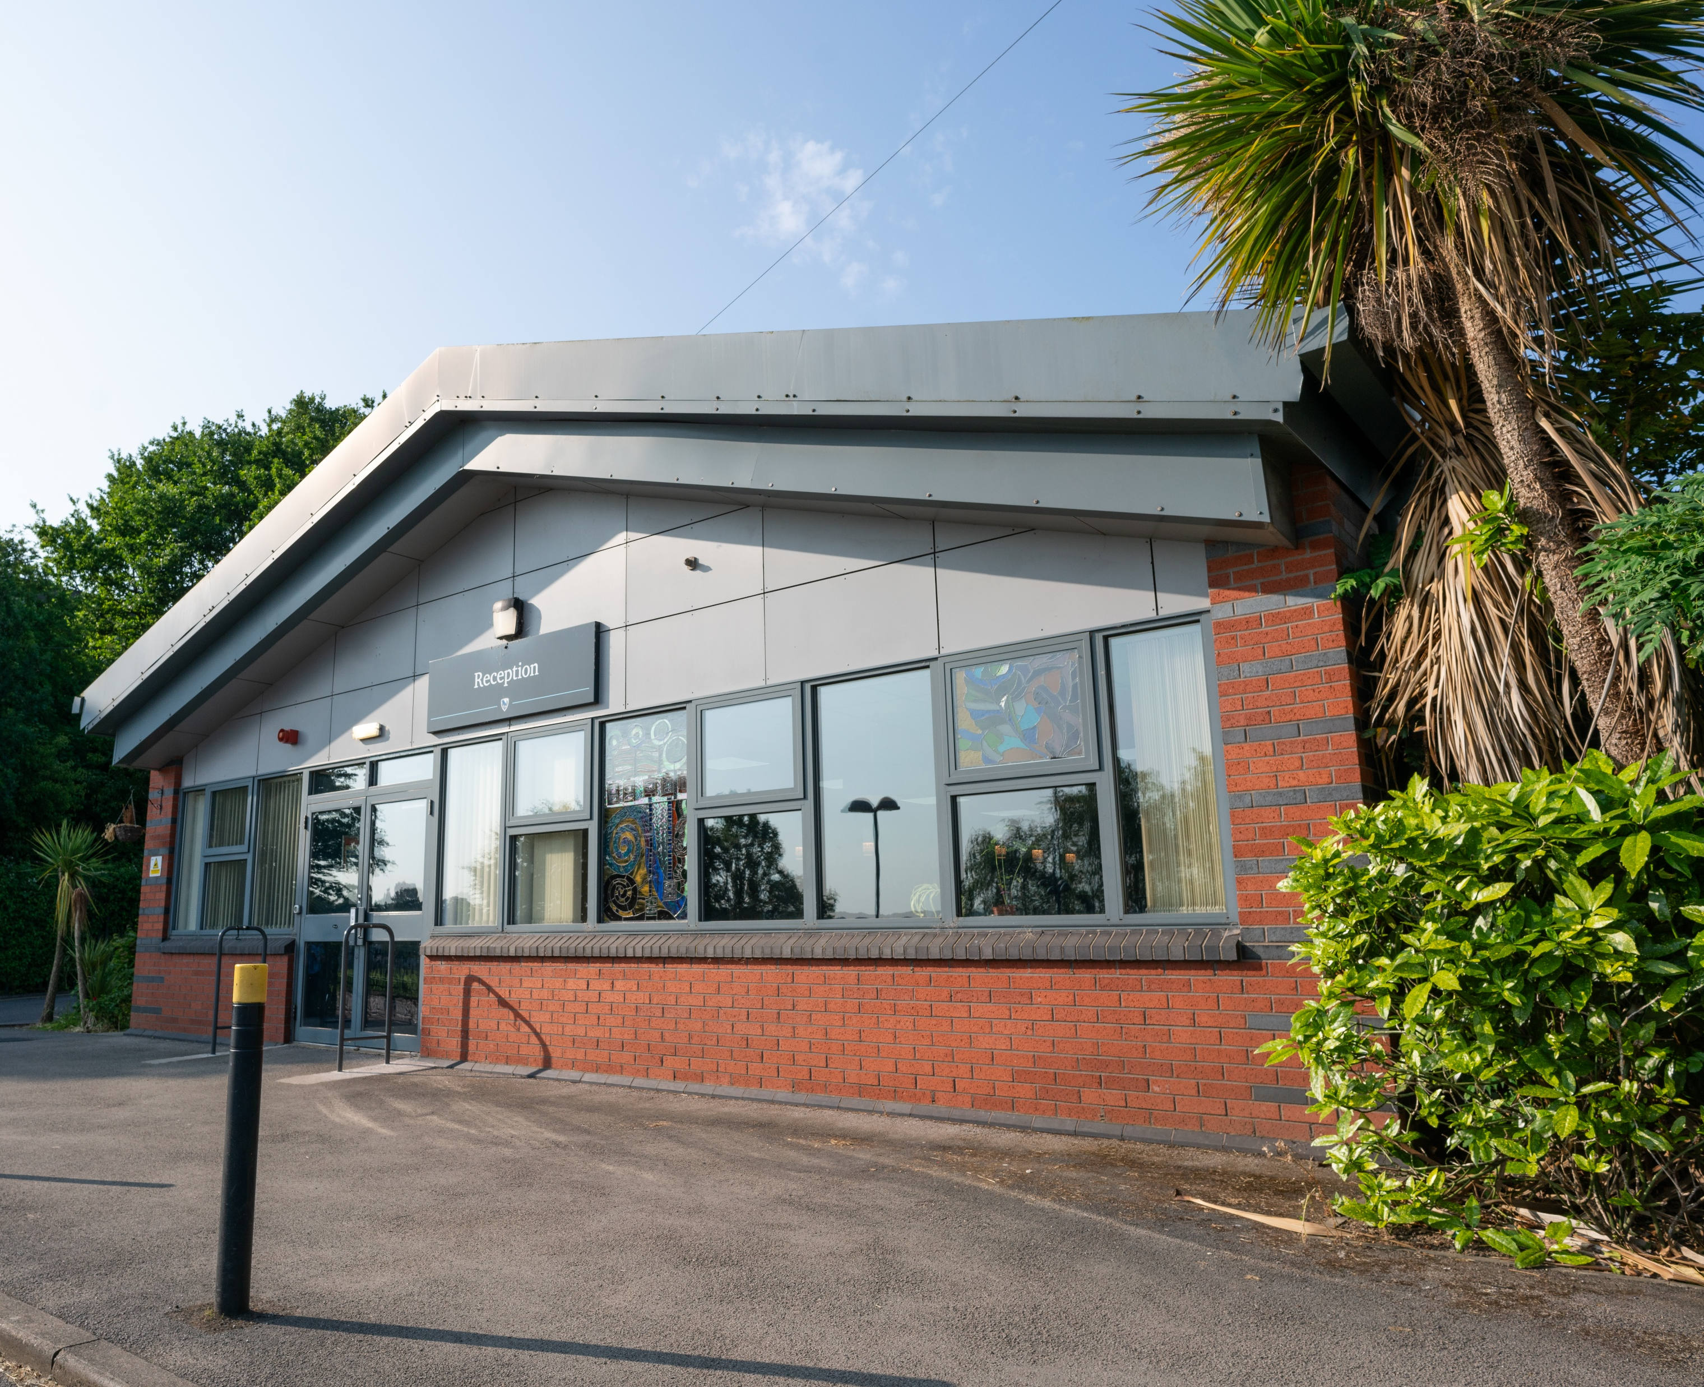
Our Values
High expectations ​
Academic achievement​
Outstanding teaching ​
Widening students’ experience ​
Equality and diversity​

Slide 8

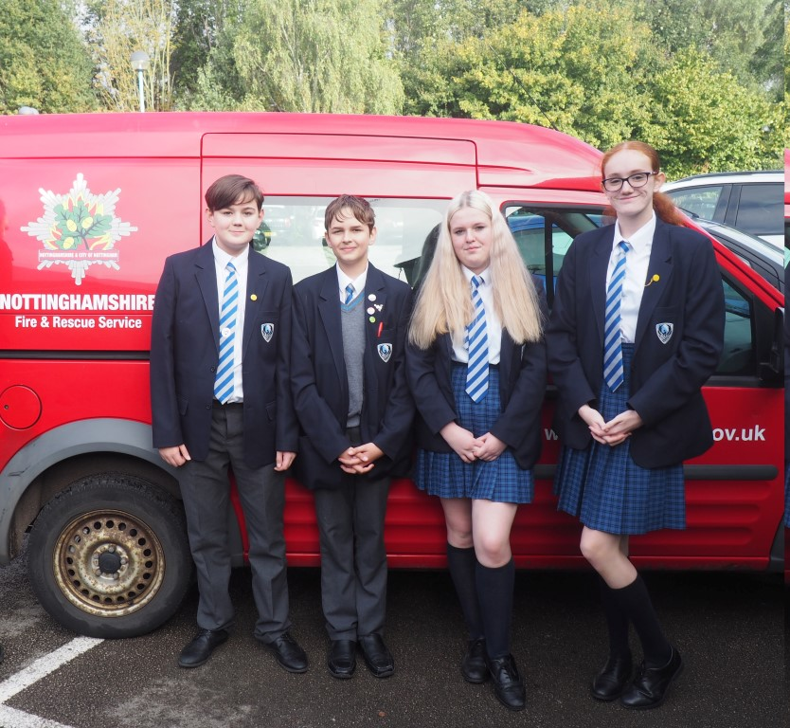

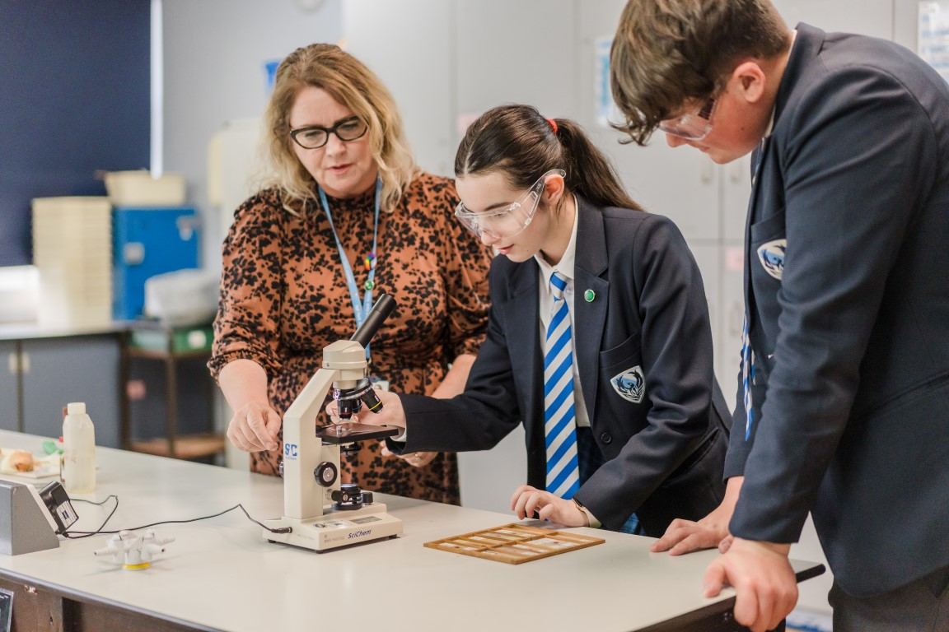
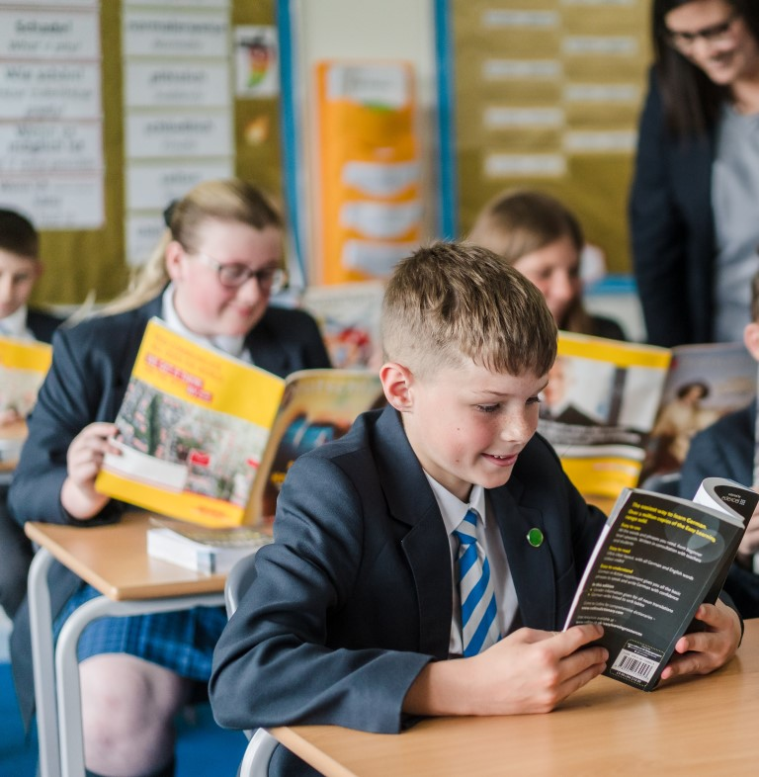
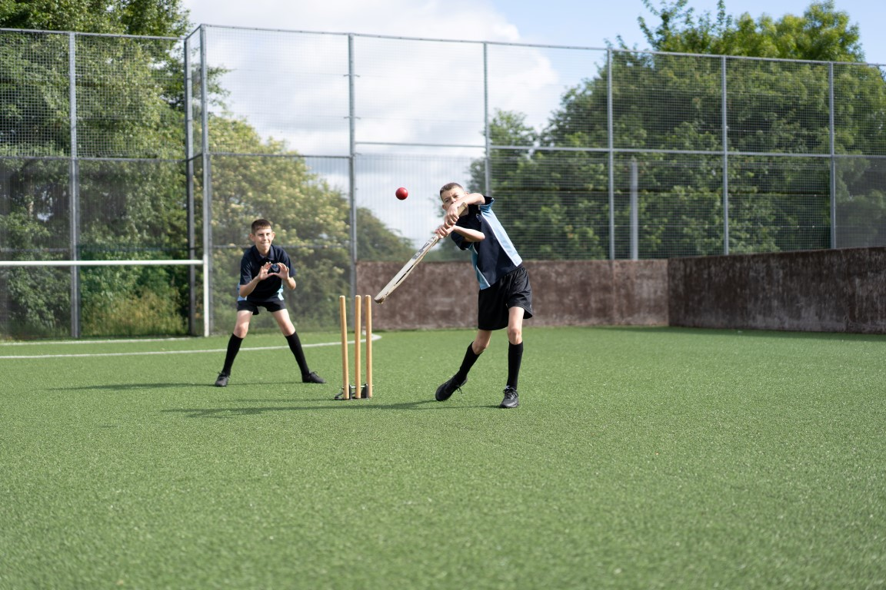
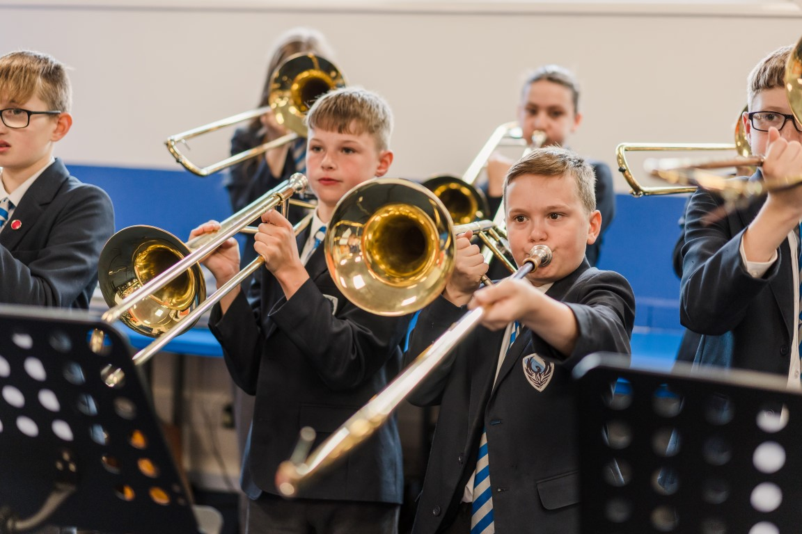
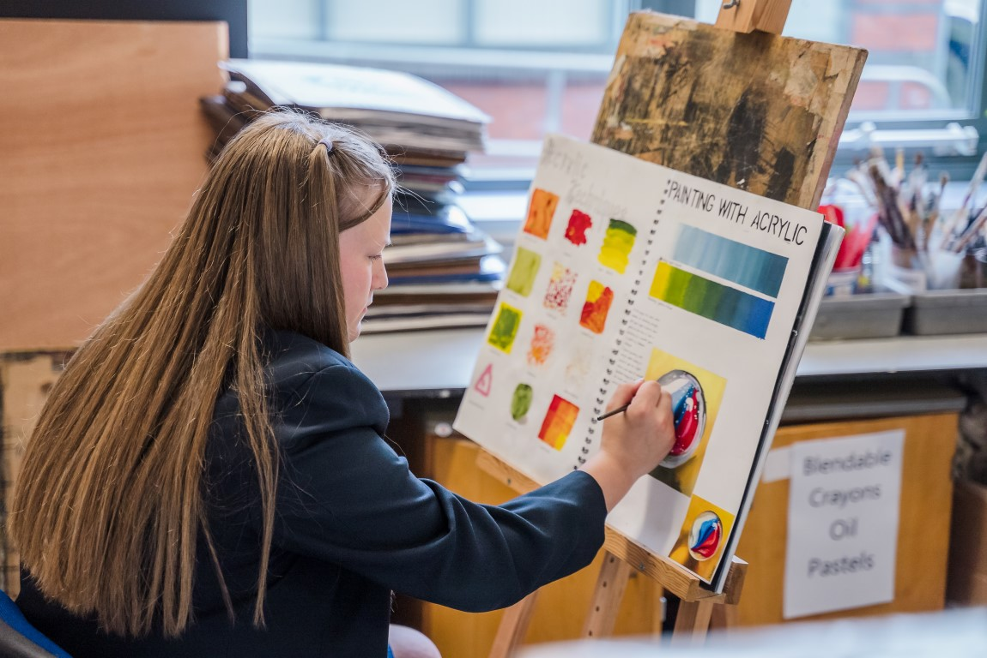
Hall Park Learner
Hard-working
Ambitious
Learner
Leader
Participant​
Ambassador​
Resilient​
Kind
HOW
WHAT
Notes:
Students role is to make themselves receptive to learning
Next step is to discuss and learn about these characteristics starting with assemblies

Slide 9

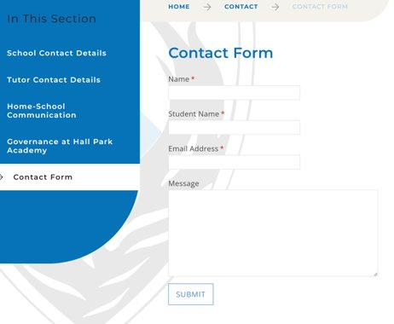
Contacting the school

Slide 10
Mr Dolman
Assistant Headteacher
Personal Development and Student Experience​
Collier House

Slide 11
Personal Development
Students have 1 lesson per week on a rolling programme​
PSHE (personal, social, health education)
RSE (relationships and sex education)
SMSC (spiritual, moral, social, cultural)
Citizenship (democracy, politics, parliament, voting) ​
Careers and aspirations
Enriched by a comprehensive trips and visits programme

Slide 12
Trips this year
Where | When
Walesby | 13 – 16 October
Southwell Minster | 19 November

Slide 13

Co Curricular
Curriculum plus booklet
Over 50 clubs running ​during lunchtime and after school​​
Please encourage your child to get involved – everyone should aim for at least 10 sessions​
All details can be found on our website

Slide 14

Pledges
To successfully participate in residential trips.​
To represent the academy in sports.​
To contribute to Academy Performing Arts events.​
To organize and actively participate in 6 different activities.​
To organize and actively participate in 3 fundraising events.​
To represent the Academy/House in 10 different events.​
To take part in community projects.​
To participate in activities that support others within the academy.​
To attend cultural or sports events out of school.​
To read 3 novels per year and complete a book review for each.

Slide 15

Anti-bullying
STOP​
Anti-Bullying Alliance and Princess Diana Trust​
Anti-bullying Week and our own annual event: Power for Good​
Report bullying to:​
Member of staff​
Anti-bullying box​
anti-bullying@hallparkacademy.org.uk​

Slide 16
Ms Brooks
Deputy Headteacher
Curriculum​
Astle House

Slide 17
Our curriculum
Engage… | Equip… | Enrich…
students with a broad and balanced range of opportunities that are carefully sequenced to enable progression | students with the knowledge and skills to succeed in education and participate fully in the modern world | students’ experiences through deep and challenging learning within and beyond the classroom
Wide range of subjects available to all students throughout their time at school​ Appropriate pathways​ Sixth Form study | Hall Park Values​ Pledges ​ Study skills and revision​ Reading ​ Personal development​ Careers | Co-curricular activities​ Trips​ D of E Awards​ Aspirations and achievement opportunities​ Special events

Slide 18
Our curriculum
Key Stage 3
Key Stage 4
Sixth Form
Year
7
Year
8
Year
9
Year
10
Year
11
Year
12
Year
13
Maths English Science ​ | History Geography Computing Design & Technology Spanish​ | Art​ Drama Music Religious Education PE

Slide 19
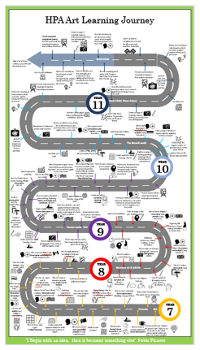

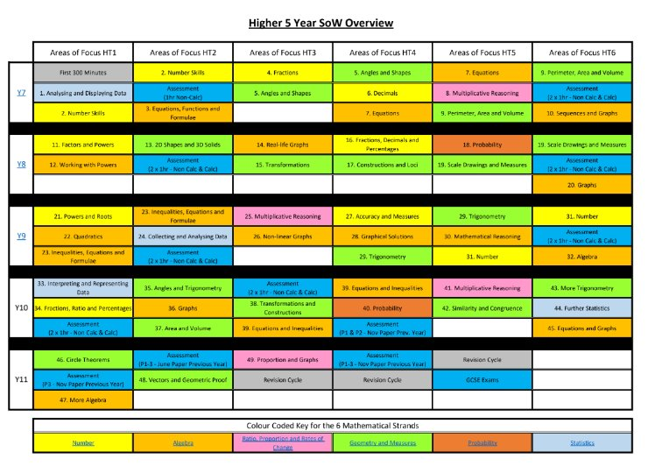
Our curriculum

Slide 20
Key Dates, Reports​
Reports​
Two DC point for Year 7 KS3​
One DC point for Year 8 and 9 ​
Two DC points for KS4 and Post 16​
Evidence/Assessment​
Year 7-9 Exams/Assessment weeks will be used to inform reporting:​
In class / Sports Hall assessments of 50-55 mins (in each subject)​
Summative Assessments​
Review weeks will be based on pastoral information

Slide 21
Target Bands
How are these set?​
Calculated from KS2 scaled scores produced from SATs.​
SATs are used to generate a GCSE target for each subject ​
At each data point in Years 7 to 9, teachers report the student’s predicted end of KS4 outcome as a Band based on KS4 grading.

Slide 22
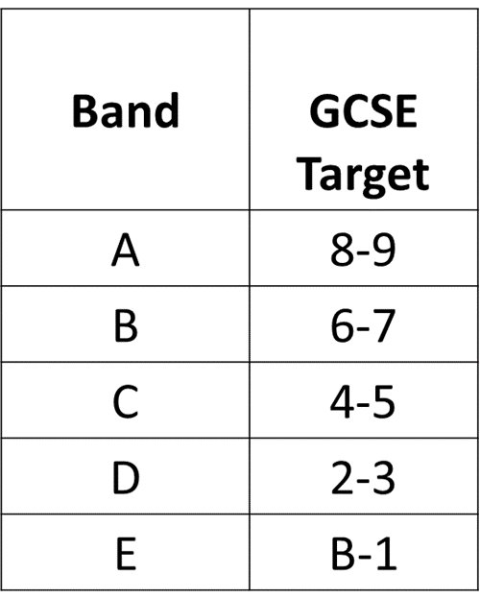
Data Collections
Using GCSE descriptors as a starting point, subjects define expected end of year skills descriptors for each Band, in each Year (7 to 9)​
Assessed work in Years 7 to 9 graded as Band A - E to indicate their predicted outcome at the end of KS4 based on the quality of that work: “a trajectory”​

Slide 23
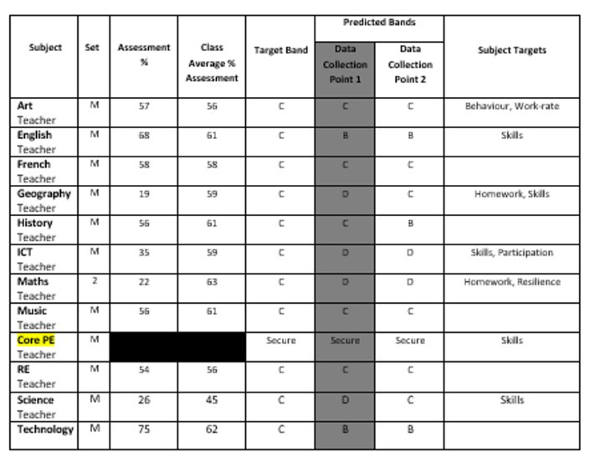
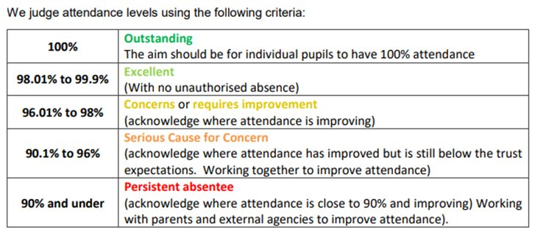
Report Example

Slide 24
Key Dates
​Tutor review week - w/c 12 January 2026​
Assessment week - w/c 16 March 2026​
Progress report - January and March 2026​
Parents' Evening - 6 May 2026​

Slide 25
Mrs Norridge
Deputy Headteacher
Behaviour and attitudes
Lawrence House

Slide 26
Importance of Attendance
Hall Park Academy attendance target = 96%​
​Importance of attendance
Government White paper:
'Opportunity for all' March 2022
​'... children will not achieve their potential in a school with poor standards of attendance'​
'Children with no absence at key stage 4 are almost 2 times more likely to achieve 5 or more GCSEs'​
​

Slide 27
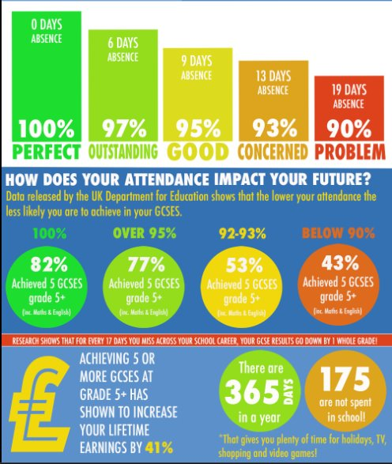
How you can support your child
Please avoid booking medical appointments during the school day​
Please do not book holidays during the school term​
Encourage your child to come into school every-day and to arrive on time​
Let school know if your child is off school for any reason
Text attendance mobile
Email attendance office
Hpa-attendanceofficersstaff@hallparkacademy.org.uk

Slide 28
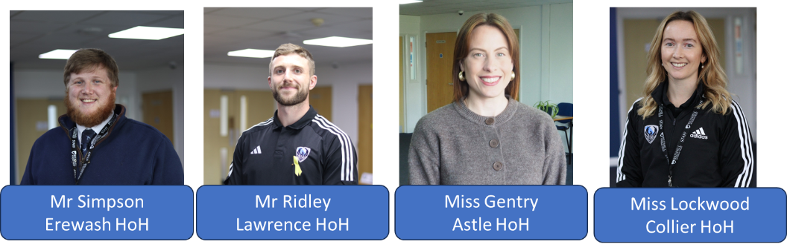
How we encourage good attendance
Students are informed about the importance of good attendance​
Weekly assembly and tutor sessions ​
Attendance dialogue​
Support from tutors, HOH, attendance team and student support centre

Slide 29

Phone pouches
All students have been lent a pouch​
Students need to lock their phone in it before they enter school ​
This will be checked in line up and in their period 1 lesson​
Students release their phones at the end of the day

Slide 30
What if…?
In an emergency students can go to house support – they can access their phone​
If students lose or damage their pouch, parents will be charged for a replacement​
If students are seen with their phone out, it will be confiscated until an adult family member collects it and a sanction will be set​

Slide 31
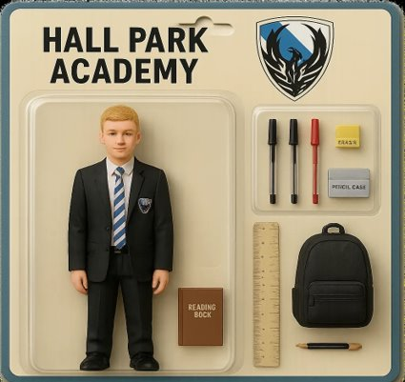
What equipment should students bring to school?
Pencil case​
Pen (blue/black)​
Pen red​
Pencil ​
Ruler​​
DEAR book (Reading book)​
Uniform Card​
School Bag​
PE kit on PE days ​

Slide 32
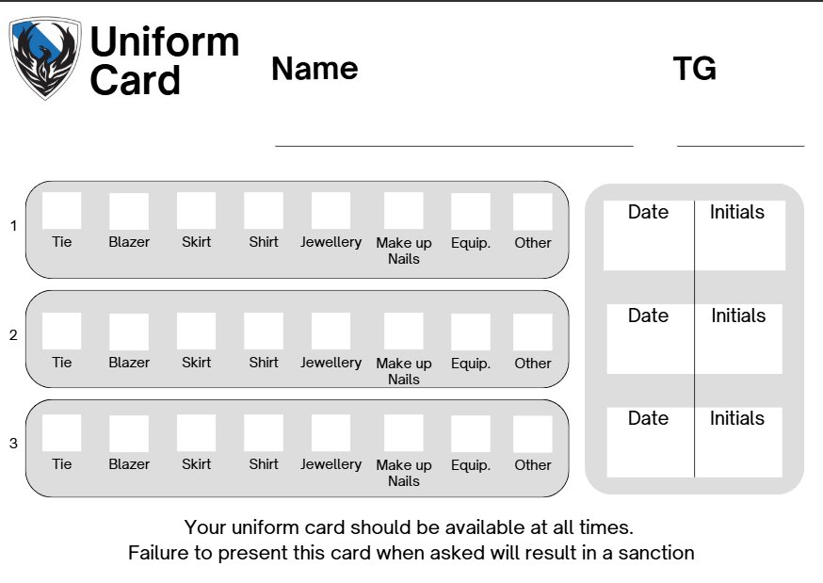
Uniform card
Students are expected to carry their uniform card with them at all times​
Any infraction, staff will ask the student to correct and the uniform card will be signed​
3 ticks on the uniform card will result in a detention​
A missing uniform card will result in a detention​

Slide 33
Miss Grainger
Assistant Headteacher
Teaching and Learning, and Quality Assurance
Erewash House

Slide 34

Reading
Please ensure your child brings their reading book every day​
Reading lessons including Accelerated Reader​
Drop Everything And Read​

Slide 35
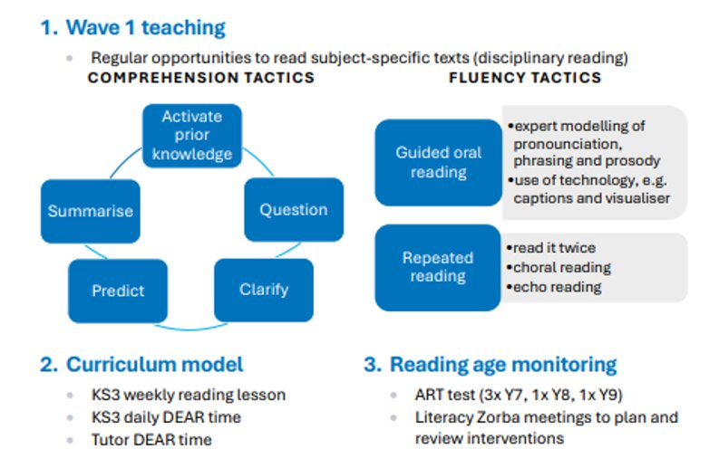

Slide 36
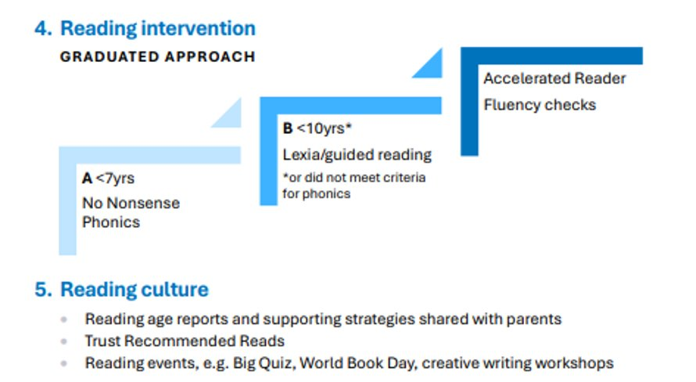

Slide 37
Homework
Set regularly to enhance students’ learning and to develop essential study skills​
30 minutes per week for English, Maths and Science​
30 minutes per fortnight for the remaining 10 subjects​
This equates to 4 hours per week​
We advise students to attempt homework the day it is set so they can seek out their teachers for any additional support​
Students access homework through Class Charts

Slide 38
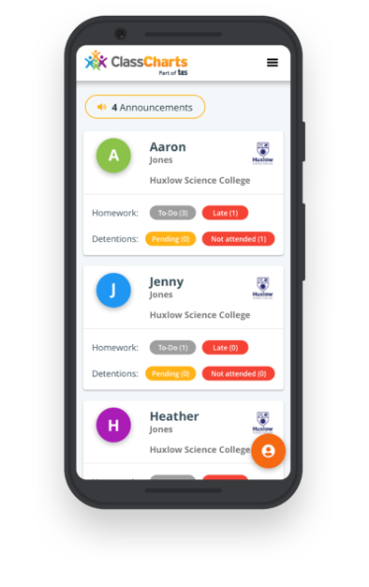



Class Charts
We use Class Charts to share homework, behaviour points and communications with students and parents​
There are separate student and parent apps​
Please speak with Miss Grainger to request a new PIN​

Slide 39
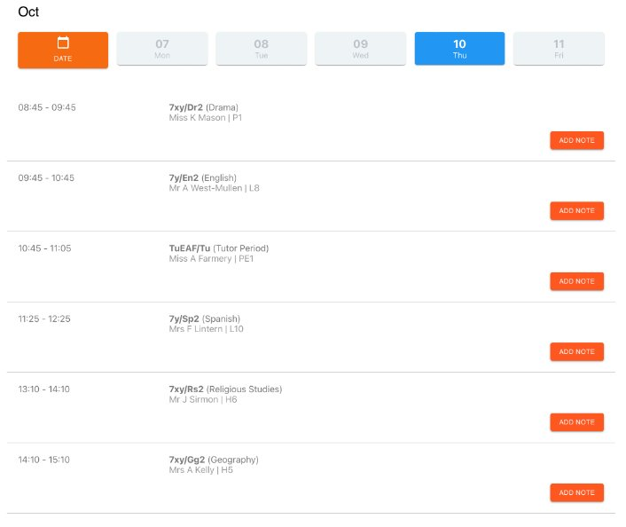

Timetable

Slide 40
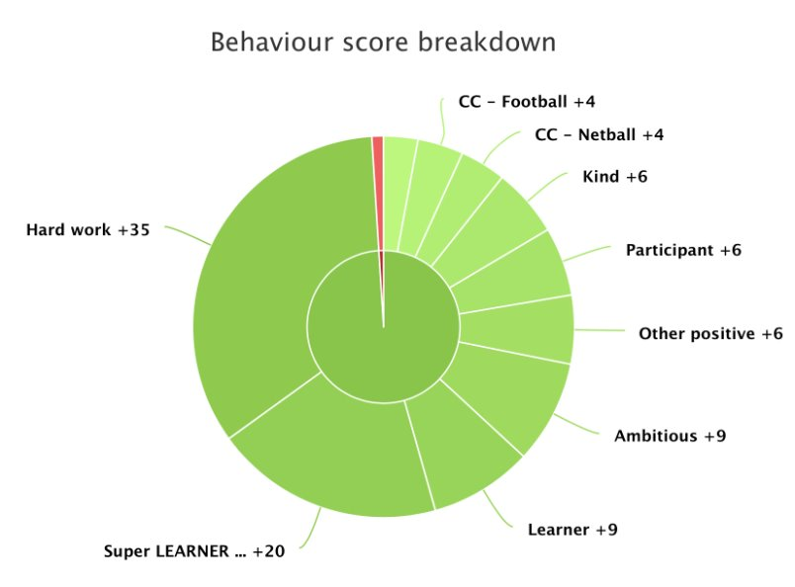
Behaviour

Slide 41
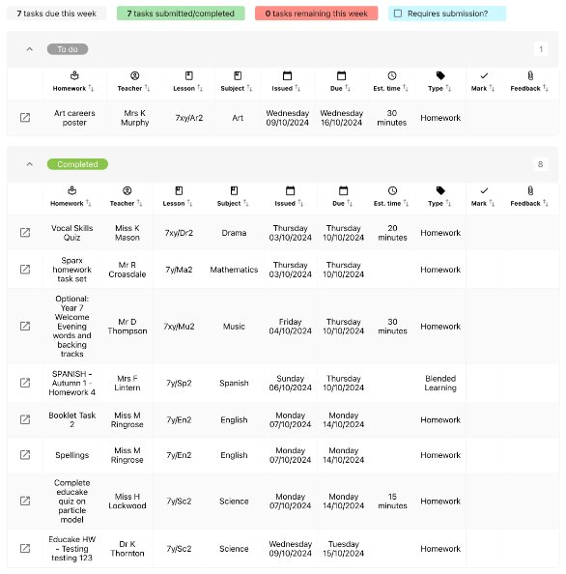
Homework

Slide 42
Any questions?
Please stay and ask a member of the leadership team
​
Mr Crossley - Headteacher​
Mr Dolman - Collier​
Ms Brooks - Astle ​
Mrs Norridge - Lawrence​
Miss Grainger - Erewash
Miss Dickman - SENDCo (Sixth Form Study Centre)

