Slide 1

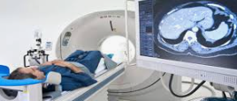
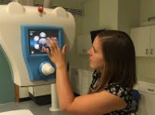
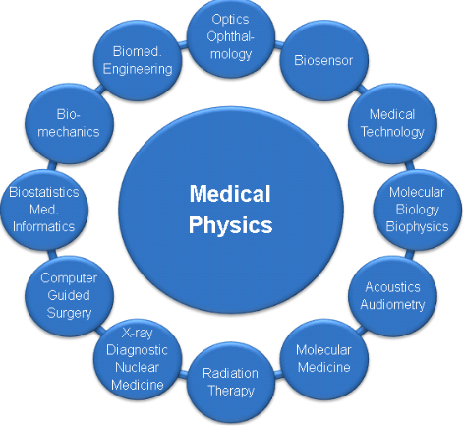
Careers in Medicine
Career of the Week
Medical Physicist

Slide 2
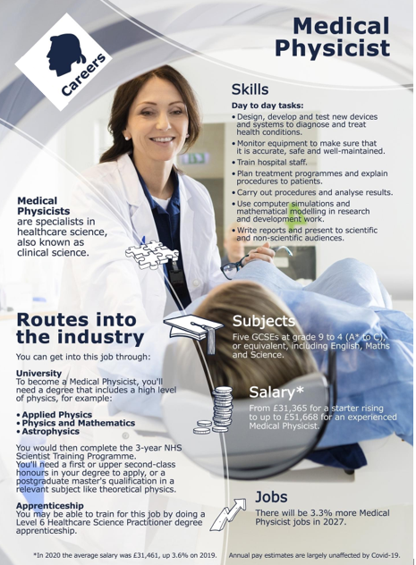
Medical physicists work in health care and apply their knowledge of physics to the development and use of medical radiation treatments, devices, and technologies.
The responsibilities of a medical physicist typically include a mixture of clinical service and consultation, research and development, and teaching.
One of the main duties of a medical physicist within the NHS is to contribute to the diagnosis and treatment of individual patients as part of a multi-disciplinary team.
Skills needed and those to be developed
Problem Solving
Analytical
Medical knowledge
Enquiry
Do you have a passion for Physics?

Slide 3
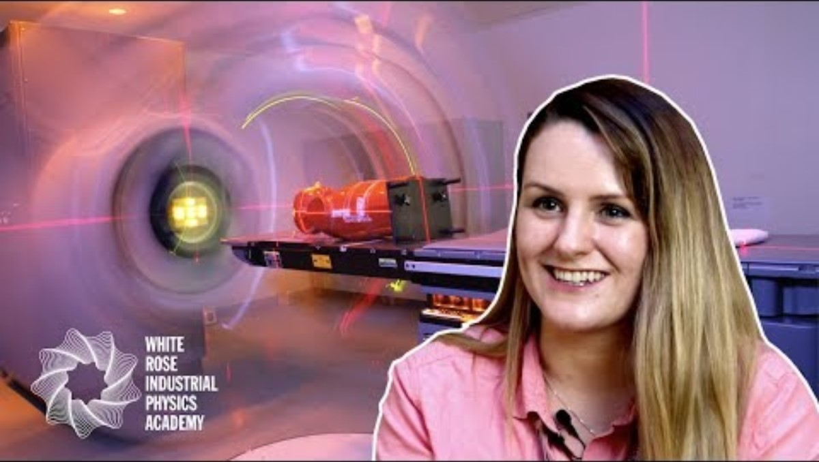



Careers in Medicine
Careers in The Rail Industry
Watch & Discuss
What is it like to be a Medical Physicist?
What do you think to this career? Write one thing you like, love or don’t like – why is this?
Have a discussion about this job as a group or in pairs.
What could be your post 16 options be, to make a further step towards this career?
Notes:
Medical Physicist - Skills and qualities | Job Information

