Slide 1


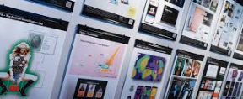

Careers in Creative Industries
Career of the Week
Advertising Art Director

Slide 2
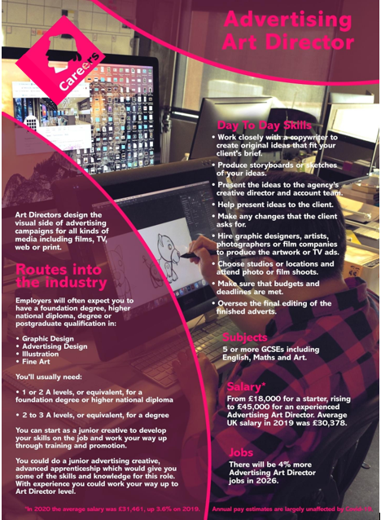
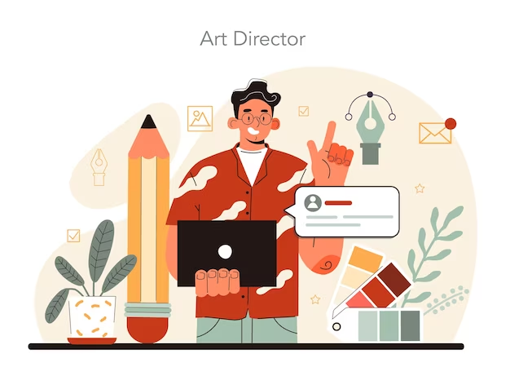
Advertising art director (also known as Creative Director) manage the visual elements of advertising campaigns for various media types. They usually have significant experience in advertising and creative roles and use their advanced skills, including project management and design skills, to fulfil their responsibilities.
As an advertising art director, you'll produce innovative ideas for the visual elements of advertising campaigns in all kinds of media, including:
cinema and television
internet (digital or viral marketing)
posters
press
radio.

Slide 3




Careers in The Rail Industry
Careers in Creative Industries
Watch & Discuss
What is it like to be an Advertising Art Director?
What do you think to this career? Write one thing you like, love or don’t like – why is this?
Have a discussion about this job as a group or in pairs.
What could be your post 16 options be, to make a further step towards this career?
Notes:
https://youtu.be/nAByLhFoZ1A?t=3

