Slide 1

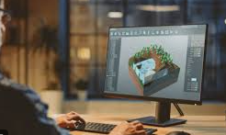
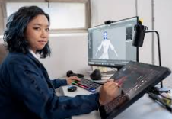

Careers in Games, Media & Computing
Career of the Week
Games Design Developer

Slide 2
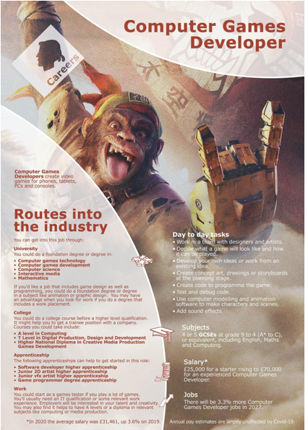
Working in games development, you'll be involved in the creation and production of games for personal computers, games consoles, social/online games, arcade games, tablets, mobile phones, and other handheld devices.
With a large games company, you may focus on a particular area of programming such as network, engine, graphic, toolchain and artificial intelligence. With a smaller independent 'indie' game producer, there's often much less of a distinction between the role of developer and designer, and your job may incorporate both programming and design.
The making of a game from concept to finished product can take years and involve teams of professionals. There are several stages, including creating and designing a game's look and how it plays, animating characters and objects, creating audio, programming, localisation, testing, editing and producing.

Slide 3
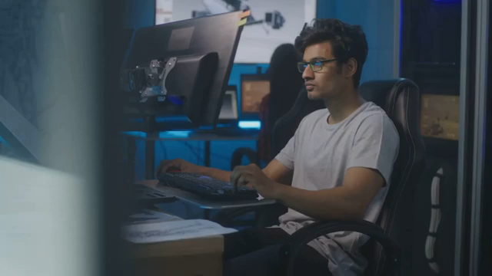



Careers in The Rail Industry
Careers in Games, Media & Computing
Watch & Discuss
What is it like to be a Games Developer?
What do you think to this career? Write one thing you like, love or don’t like – why is this?
Have a discussion about this job as a group or in pairs.
What could be your post 16 options be, to make a further step towards this career?
Notes:
https://youtu.be/nAByLhFoZ1A?t=3

