Slide 1

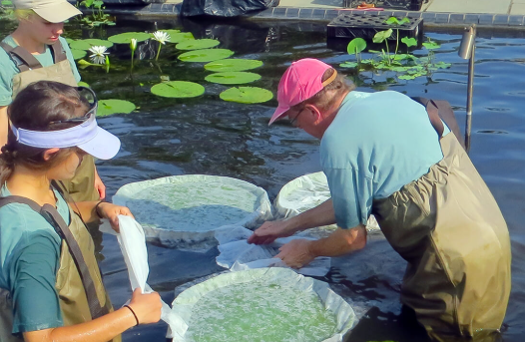
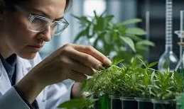
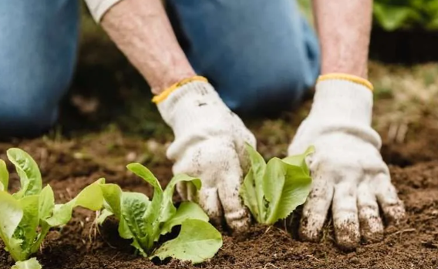
Careers in Agriculture & Environmental Conservation
Career of the Week
Botanist

Slide 2
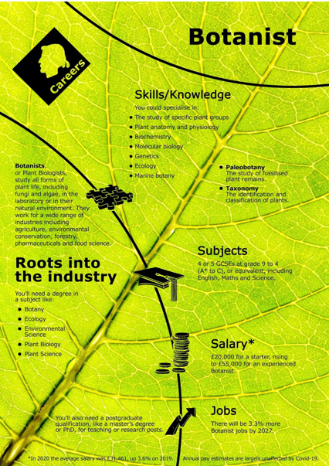

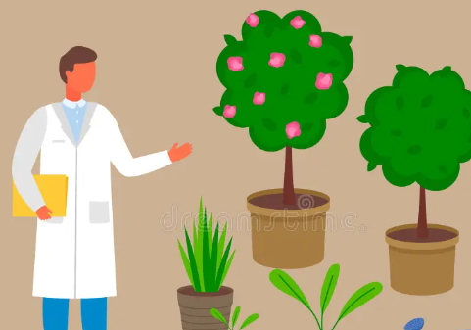
Botanists, or Plant Biologists, study all forms of plant life, including fungi and algae, in the laboratory or in their natural environment. They work for a wide range of industries including agriculture, environmental conservation, forestry, pharmaceuticals and food science.
Because the field is so broad, there are many kinds of plant biologists and many different career and study opportunities available. Botanists interested in ecology study interactions of plants with other organisms and the environment. Other field botanists search to find new species or do experiments to discover how plants grow under different conditions. Some botanists study the structure of plants. They may work in the field, concentrating on the pattern of the whole plant.

Slide 3




Careers in The Rail Industry
Careers in Agriculture & Environmental Conservation
Watch & Discuss
What is it like to be a Botanist?
What do you think to this career? Write one thing you like, love, or not sure of.
Have a discussion as a group or in pairs. Think of a reason why and share with the group.
What could be your post 16 options be, to make a further step towards this career?

