Slide 1




Careers in Media
Career of the Week
Media Researcher

Slide 2
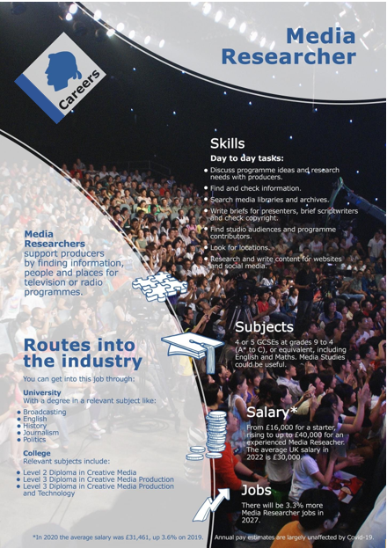
As a Media researcher, you'll source contacts and contributors for programmes, as well as supply your own ideas and work on location. Some media researchers also help with filming or sound recording.
The work involves organising, planning and researching everything that will happen during a programme. This includes collecting and verifying information, such as who'll be interviewed, the location, if the film crew will fit, if the budget will stretch and so on. You're also responsible for fact-checking, writing briefs for presenters and ensuring that production adheres to the appropriate legislation.
Top 3 skills
Verbal communication
Investigate and Source Information
Attention to detail
Media Researcher Places to Work
Here are some current job opportunities for media researchers in the UK:
Social Media Manager at MMR Research - Nottingham
Media Search Analyst at TELUS Digital - Remote
Social Researcher at Department for Culture, Media & Sport - Manchester
Notes:
7 types of nutritionists (Plus salaries and duties) | Indeed.com UK – more information check our national careers service or indeed career guide UK

Slide 3
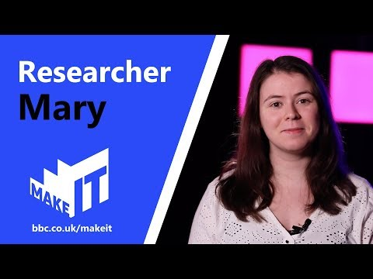
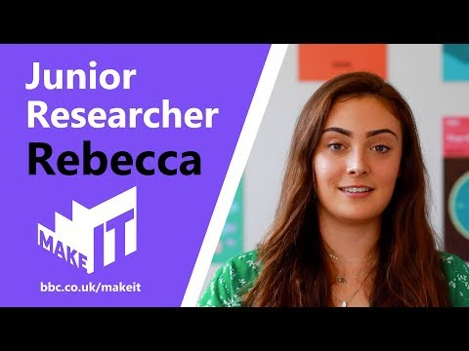



Careers in The Rail Industry
Careers in Media
Watch & Discuss
What is it like to be a Media Researcher?
What do you think to this career? Write one thing you like, love, or not sure of.
Have a discussion as a group or in pairs. Think of a reason why and share with the group.
What could be your post 16 options be, to make a further step towards this career?

