Slide 1


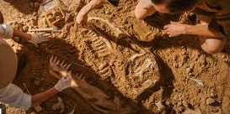
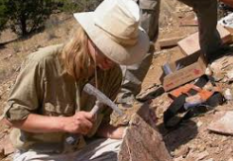
Careers in Natural Science
Career of the Week
Palaeontologist

Slide 2
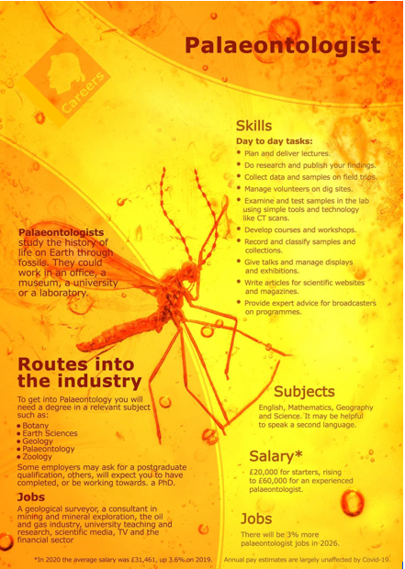
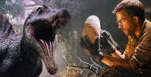
The simplest definition of "paleontology" is the study of ancient life. The field seeks information about several aspects of past organisms: their identity and origin, their environment and evolution, and what they can tell us about the Earth's organic and inorganic past.
As a palaeontologist, you'll study fossilised past life including plants as well as animals. Through understanding how the Earth and biodiversity has changed over millions of years, palaeontologists can try to predict how it might change in the future.
Common career paths within Paleontology:
Research Scientist: Conduct fieldwork to discover fossils, analyze them in laboratories, and publish findings in scientific journals.
University Professor: Teach courses in paleontology, geology, or biology, and conduct research.
Museum Curator: Manage fossil collections, design exhibits, and educate the public about paleontological discoveries.
Science Journalist: Write articles about paleontological discoveries and research for magazines, journals, or online publications.
Park Ranger: Protect natural resources, conduct tours, and sometimes uncover fossils in national parks.
Notes:
13 jobs in palaeontology (with primary duties and salaries) | Indeed.com UK

Slide 3
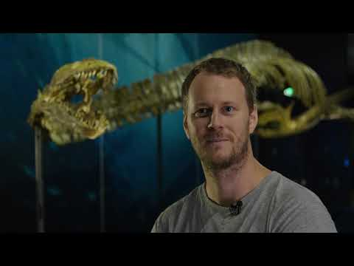




Careers in The Rail Industry
Careers in Natural Science
Watch & Discuss
What is it like to be a Palaeontologist?
What do you think to this career? Write one thing you like, love, or not sure of.
Have a discussion as a group or in pairs. Think of a reason why and share with the group.
What could be your post 16 options be, to make a further step towards this career?
More careers information at National Careers Service, Prospects of Indeed Career Guide

