Slide 1

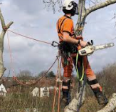
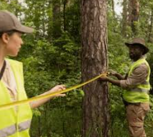
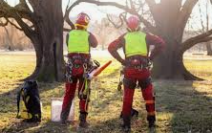
Careers in Agriculture
Career of the Week
Tree Surgeon/Arborist

Slide 2
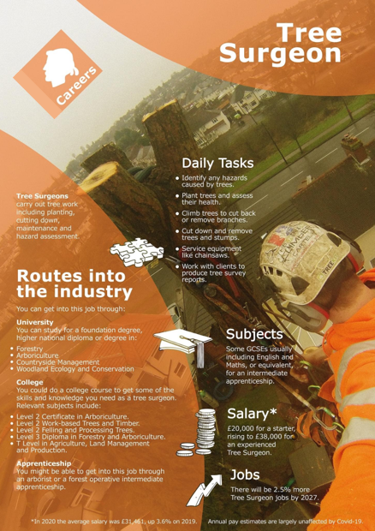
Arboriculture is a great career choice for people who enjoy being outdoors and who have a genuine interest in trees. As a tree surgeon, you’ll be protecting, maintaining and nurturing trees and shrubs – not just chopping them down. You will be handling heavy-duty machinery, will need to have a good head for heights and be happy working outside in all weather conditions.
Tree surgeons work in towns and the countryside, assessing tree health, removing branches, planting new stock and felling unsafe trees. Also known professionally as an arborist, they are responsible for the planting, pruning, felling, and general care and maintenance of trees and hedges.
Did you know an alternative name for a Tree Surgeon is also an Arborist
Arborists – know not only how to cut trees, but they study the health and biology of trees. Vital for the environment and urban landscapes.
Notes:
7 types of nutritionists (Plus salaries and duties) | Indeed.com UK – more information check our national careers service or indeed career guide UK

Slide 3
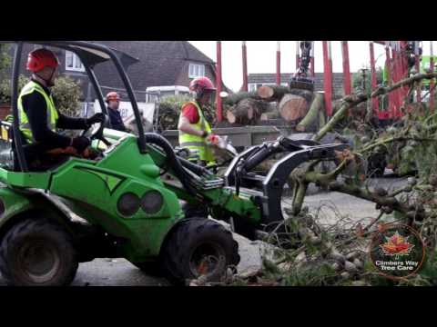



Careers in The Rail Industry
Careers in Agriculture
Watch & Discuss
What is it like to be a Tree Surgeon or an Arborist?
What do you think to this career? Write one thing you like, love, or not sure of.
Have a discussion as a group or in pairs. Think of a reason why and share with the group.
What could be your post 16 options be, to make a further step towards this career?

