Slide 1



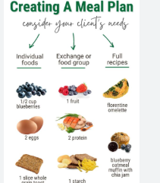
Careers in The Food & Health Industry
Career of the Week
Nutritionist

Slide 2
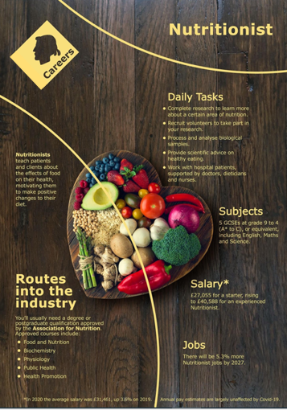

A nutritionist is a person who advises others on matters of food and nutrition and the impacts it has on their health. Some people specialise in particular areas, such as sports nutrition, public health, or animal nutrition, among other disciplines. Nutritionists are the heart of a patient's health by using their knowledge of the science of food to help individuals and groups make the right choices about what they eat.
Different Types of Nutritionists
Clinical Nutritionist: Works in healthcare settings like hospitals and clinics, providing medical nutrition therapy to patients.
Sports Nutritionist: Specializes in nutrition for athletes and active individuals to enhance performance and recovery.
Public Health Nutritionist: Focuses on community health and nutrition programs, often working with government or non-profit organizations.
Animal Nutritionist: Studies and advises on the dietary needs of animals, often working in veterinary settings or with pet food companies.
Food Service Nutritionist: Works in food service management, ensuring that meals provided in institutions like schools and hospitals meet nutritional standards.
Research Nutritionist: Conducts studies and research on various
aspectsof nutrition and its impact on health.
Corporate Nutritionist: Provides nutrition advice and wellness programs within corporate settings to promote employee health.
Nutritional Therapist: Uses nutrition to help manage and prevent health issues, often working in private practice.
Notes:
7 types of nutritionists (Plus salaries and duties) | Indeed.com UK – more information check our national careers service or indeed career guide UK

Slide 3




Careers in The Rail Industry
Careers in The Food & Health Industry
Watch & Discuss
What is it like to be a Nutritionist?
What do you think to this career? Write one thing you like, love, or not sure of.
Have a discussion as a group or in pairs. Think of a reason why and share with the group.
What could be your post 16 options be, to make a further step towards this career?

