Slide 1


NATIONAL APPRENTICESHIP WEEK
Watch a video here to learn more about apprenticeships
Communications will be published on class charts for apprenticeship websites and resources
Notes:
7 mins video

Slide 2



Careers in Engineering
Career of the Week
Civil Engineer

Slide 3
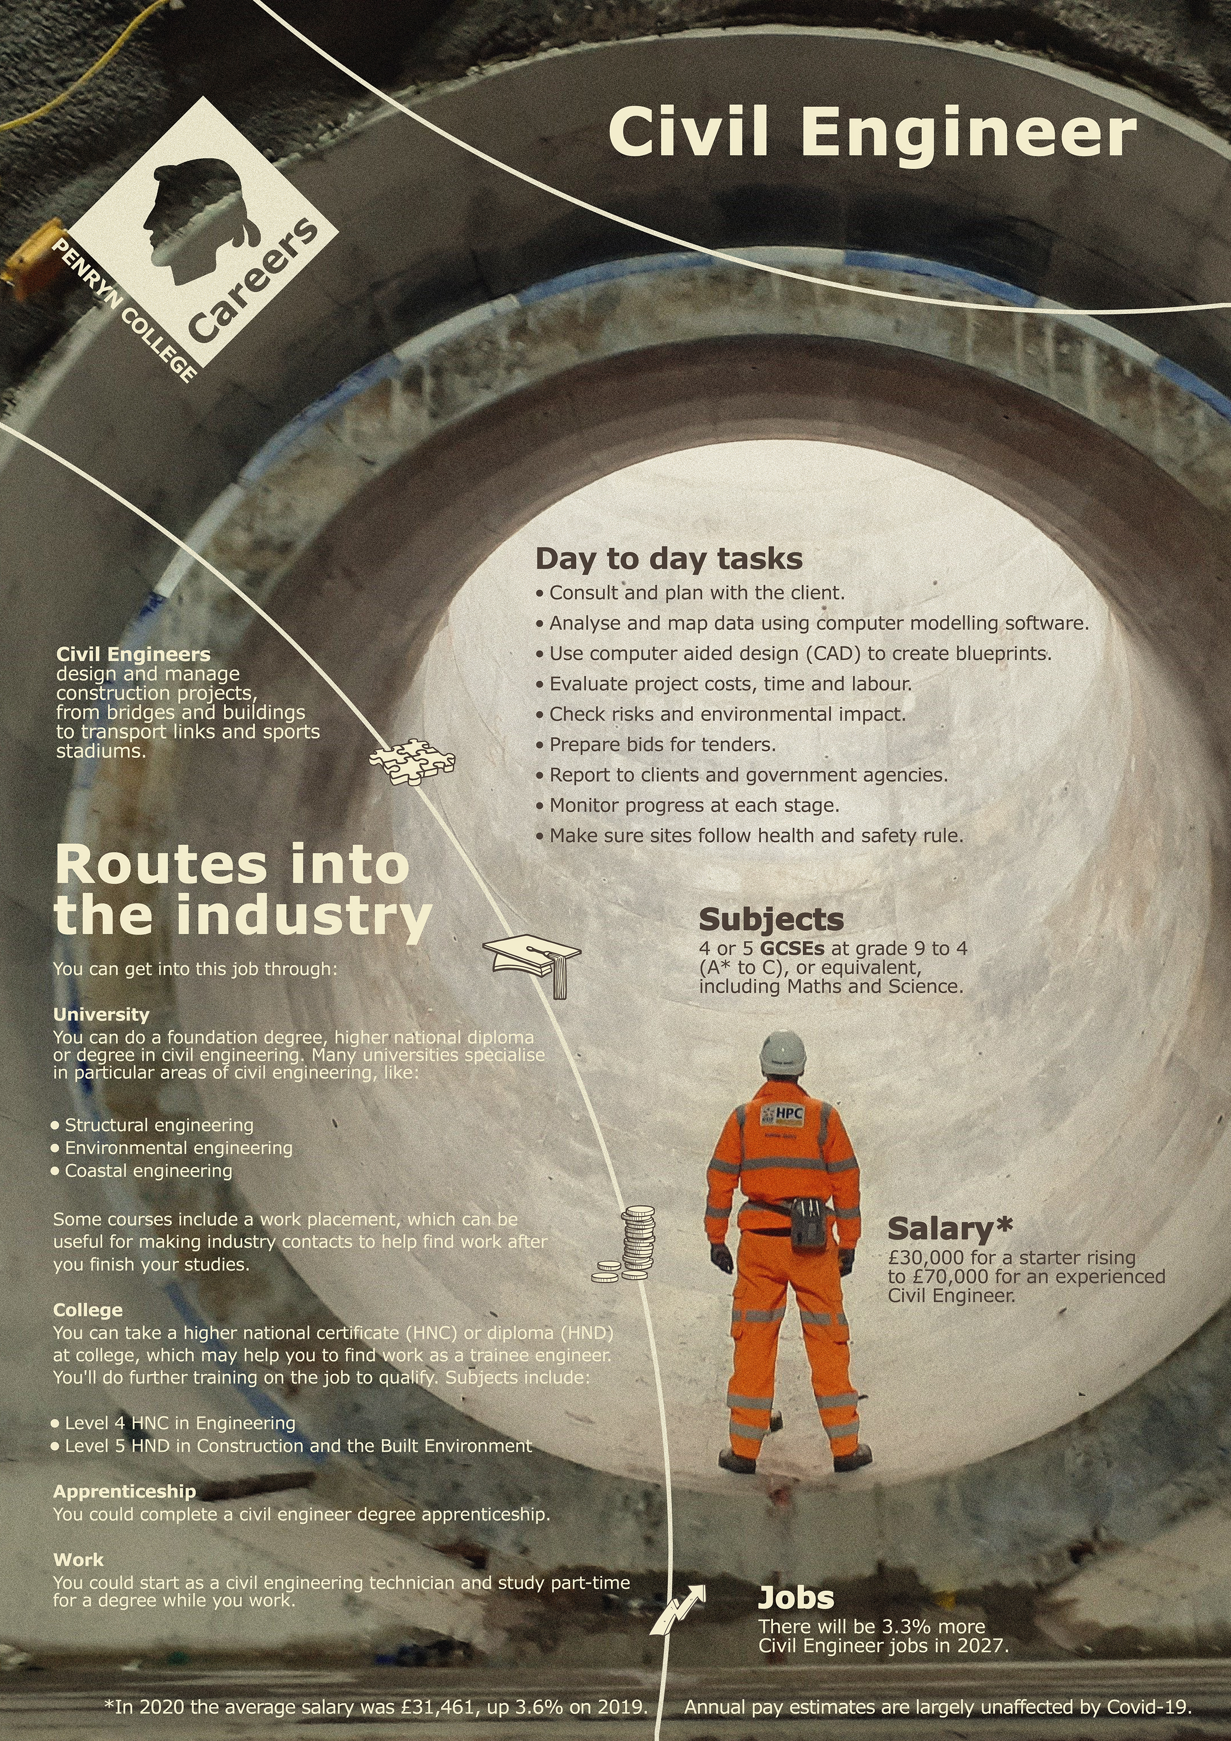

Careers in The Rail Industry
Civil engineers are the scientific minds behind the way our modern towns and cities work. Responsible for infrastructure on a large scale, Civil engineering is a professional engineering discipline that deals with the design, construction, and maintenance of the physical and naturally built environment, including public works such as roads, bridges, canals, dams, airports, sewage systems, pipelines, structural components of buildings, and railways.
Key Skills to Become A Civil Engineer
Soft Skills – Personal skills and qualities
Communication – Talk about the ideas and technical details to clients and stakeholders, eg present a project plan.
Teamwork – be able to work with a mix of people from different background. Work well with others.
Problem solving – projects can be complex, fraught with challenges. Creative problem solving is key.
Hard Skills – Technical skills
Technical knowledge – in-depth knowledge of civil engineering principles, structures, material, geotechnics, hydraulics and environment engineering.
Computer Aided Design – Be able to use technology for design, like AutoCAD and project planning software

Slide 4
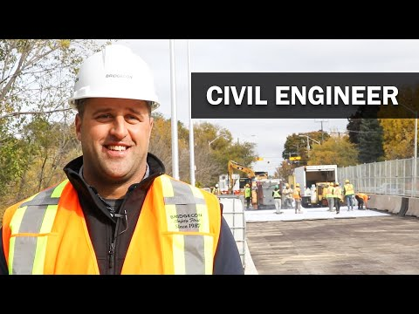




Careers in The Rail Industry
Careers in Civil Engineering
Watch & Discuss
What is it like to be a Civil Engineer?
What do you think to this career? Write one thing you like, love, or not sure of.
Have a discussion as a group or in pairs. Think of a reason why and share with the group.
What could be your post 16 options be, to make a further step towards this career?
4 min watch
What is it like to be an apprentice Civil Engineer?
4 min watch

