Slide 1

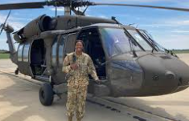
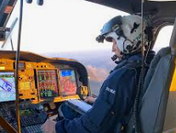
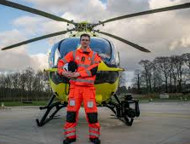
Careers in The Aviation Industry
Career of the Week
Helicopter Pilot

Slide 2
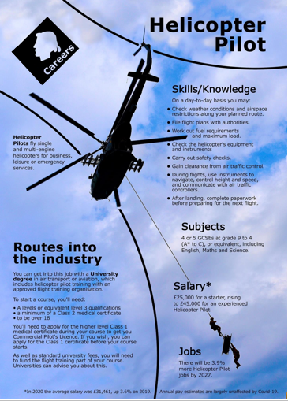
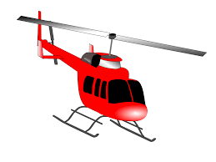
The role of a helicopter pilot is to transport passengers from one place to another by air transport. There are a wide variety of careers for qualified helicopter pilots.
You can work as an offshore pilot transferring workers to oil rigs, take tourists on airborne sightseeing tours, undergo specialist rotary training, become a pilot with the armed forces or save lives alongside doctors and paramedics flying an air ambulance.

Slide 3
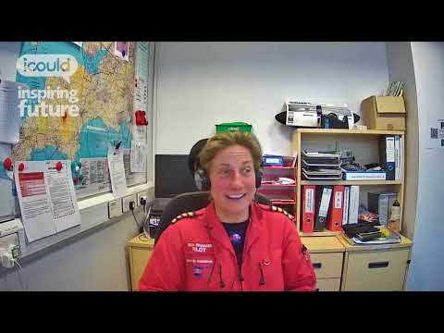



Careers in The Rail Industry
Careers in The Aviation Industry
Watch & Discuss
What is it like to be a Helicopter Pilot?
What do you think to this career? Write one thing you like, love, or not sure of.
Give one reason why?
Have a discussion as a group or in pairs
What could be your post 16 options be, to make a further step towards this career?

