Slide 1

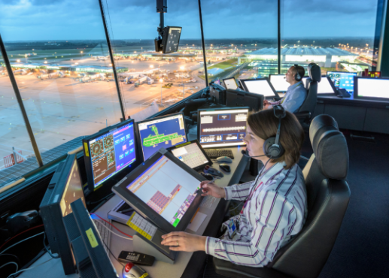
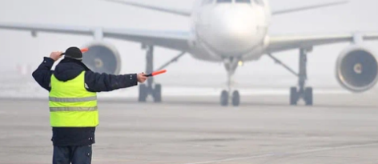
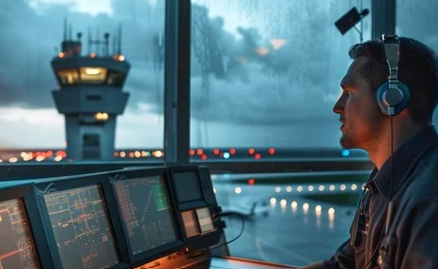
Careers in The Aviation Industry
Career of the Week
Air Traffic Controller

Slide 2
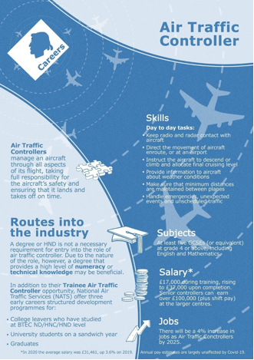
When the holidays approach, the skies will be full of planes travelling the globe and air traffic control will be working at large capacity to route aircrafts from A to B.
Air traffic control is a service provided by ground-based air traffic controllers who direct aircrafts on the ground and through a given section of controlled airspace and can provide advisory services to an aircraft in non-controlled airspace.
The primary purpose worldwide is to prevent collisions, organise and expedite the flow of air traffic, and provide information and other support for pilots. Air traffic controllers monitor the location of aircraft in their assigned airspace by radar and communicate with the pilots by radio.
Key Skills : Do you have, or would you like to develop these?
Concentration
Use judgment
Make decisions
Excellent verbal communication

Slide 3
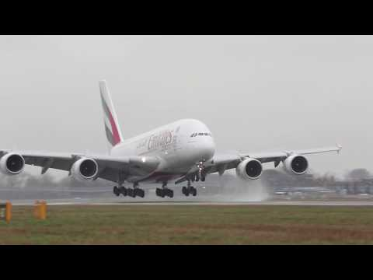



Careers in The Rail Industry
Careers in The Aviation Industry
Watch & Discuss
What is it like to be an Air Traffic Controller?
What do you think to this career? Write one thing you like, love, or not sure of.
Give one reason why?
Have a discussion as a group or in pairs
What could be your post 16 options be, to make a further step towards this career?

