Slide 1

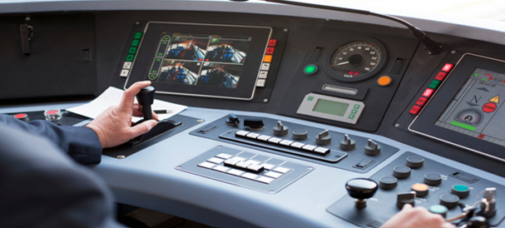
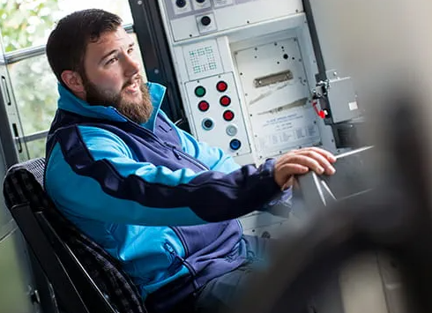
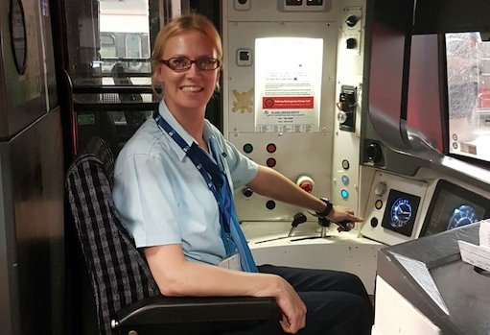
Careers in The Rail Industry
Career of the Week
Train Driver

Slide 2
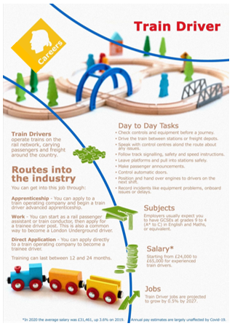
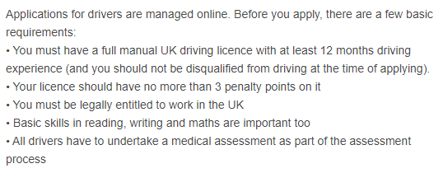
A train engine driver, engineman, locomotive driver or railroad engineer is commonly known as a Train Driver.
The driver is in charge of and is responsible for the mechanical operation of the train, train speed, and all of the train handling (also known as brake handling). A hostler (also known as a switcher) moves engines around rail yards but does not take them out on the main line tracks, also known as a shunter.
Example of basic requirements from job advert for Trainee Bus Driver Nottingham City Transport

Slide 3

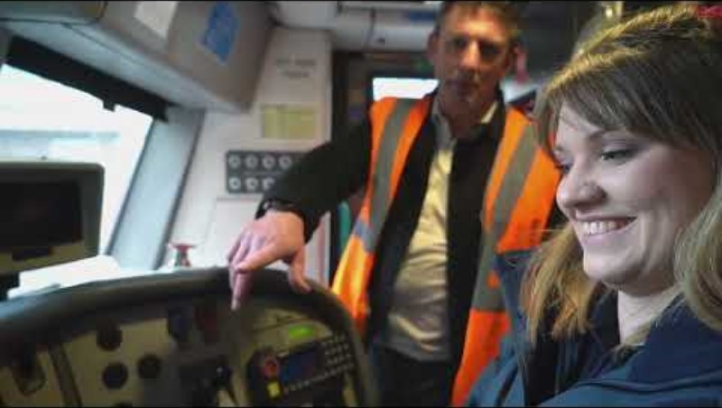



Careers in The Rail Industry
Watch & Discuss
What is it like to be a Train Driver.....? Find out here at Northern Trains.
What do you think to this career? Write one thing you like, love or not sure of.
Do You Like it, Love it or Not Like it?
Give one reason why?
Have a discussion in your tutor or in pairs
What could be your post 16 next steps be to pursue this career choice?
What is it like to be an apprentice Train Driver at East Midlands Railway?

