Slide 1

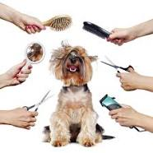
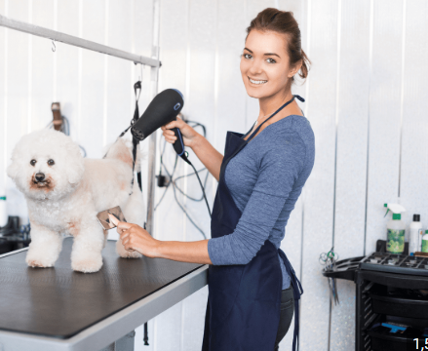
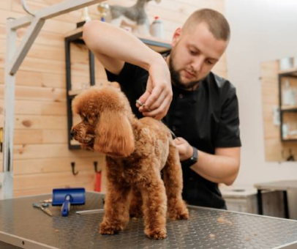
Careers in Animal Care
Career of the Week
Dog Groomer

Slide 2
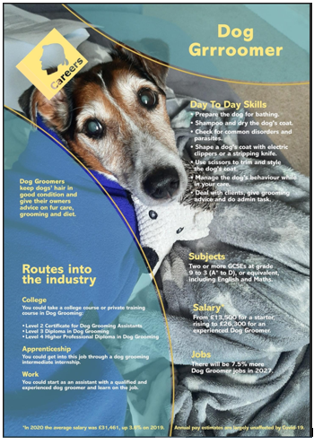



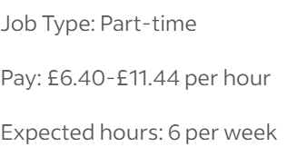
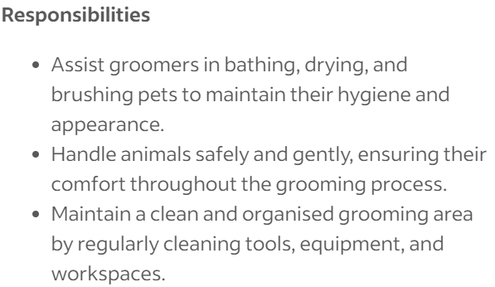
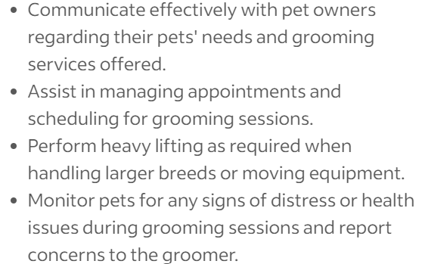
Dog grooming refers to both the hygienic care and cleaning of a dog, as well as a process by which a dog's physical appearance is enhanced for showing or other types of competition. A dog groomer is a person who earns their living grooming dogs. These jobs can be part time, full time, employed or freelance (self-employed)
Example Live Job Advert From Indeed

Slide 3
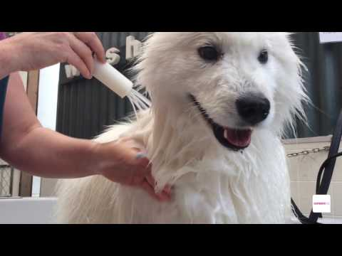



Careers in Animal Care
Watch & Discuss
What do you think to this career?
Do You Like it, Love it or Not Like it?
Give reasons why?
What could be your post 16 next steps be to pursue this career choice?

