Slide 1

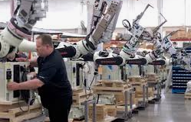

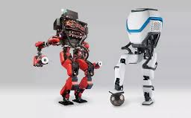

Careers in Technology and Engineering
Career of the Week
Robotics Engineer

Slide 2
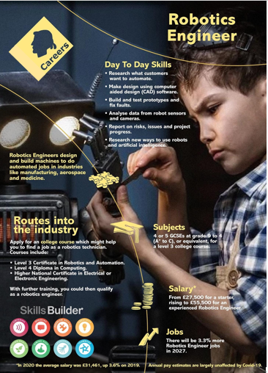
Robotics engineering is a field of engineering which centres on building machines that replicate human actions. A robotics engineer creates these applications or autonomous machines (aka robots) for industries such as mining, manufacturing, automotive, services and more.
Can you list different industries which make and use products or services designed and made by robotics engineers? List your ideas….
Manufacturing – Welding, Painting and Assembly Robots
Healthcare – Surgical robots for surgeries and for rehabilitation for mobility support
Agriculture – Robots for planting, harvesting and weeding
Transportation – Autonomous vehicles
Retail – Customer service robots and inventory robots for stock taking
Aerospace and Defence – Drones for surveillance, robotic arms for satellite maintenance
Notes:
Robotics engineers are involved in designing and creating products across a wide range of industries. Here are some key industries and examples of products they work on:
Manufacturing:
Industrial robots for tasks like welding, painting, and assembly.
Automated guided vehicles (AGVs) for material handling¹².
Healthcare:
Surgical robots like the da Vinci Surgical System for minimally invasive surgeries.
Robotic exoskeletons for rehabilitation and mobility assistance¹².
Agriculture:
Agricultural robots (agribots) for planting, harvesting, and weeding.
Robotic milking systems for dairy farming¹².
Logistics and Warehousing:
Automated storage and retrieval systems (AS/RS) for inventory management.
Delivery drones for transporting packages¹².
Construction:
Robotic bricklayers and 3D printing robots for building structures.
Drones for site surveying and monitoring¹².
Transportation:
Autonomous vehicles for personal and commercial use.
Self-driving delivery robots for last-mile delivery¹².
Retail:
Inventory robots for stock management.
Customer service robots for assisting shoppers².
Aerospace and Defense:
Drones for surveillance and reconnaissance.
Robotic arms for satellite maintenance and repair³.
Hospitality:
Service robots for delivering items to guests.
Cleaning robots for maintaining facilities¹.
Ocean and Space Exploration:
Underwater robots for marine research.
Rovers and landers for exploring other planets¹.
These examples highlight the diverse applications of robotics engineering, showcasing how robots enhance efficiency, safety, and innovation across various sectors. Is there a specific industry or product you’re particularly interested in?
Learn more
1siliconwit.com2mondo.com3geeksforgeeks.org4coursera.org5upwork.com— See Less
1of30responses

Slide 3




Careers in Technology and Engineering
Watch & Discuss
A typical day in Robotics:
What do you think to this career?
Do You Like it, Love it or Not Like it?
Give reasons why?

