Slide 1




Careers in Finance & Accounting
Career of the Week
Tax Expert

Slide 2
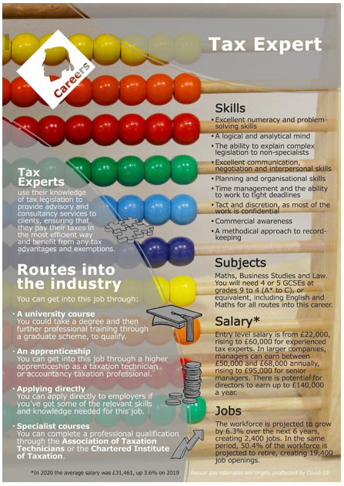

A tax advisor or tax expert is a person with advanced training and knowledge of tax law. The services of a tax advisor are usually retained in order to minimise taxation while remaining compliant with the law in complicated financial situations.
What are the benefits?
Varied Work.
Responsibility.
Working with diverse clients and companies.
Mentally stimulating, numbers, logic, and problem solving!
Great remuneration and salary.
Growing career area.
One Route…..

Slide 3
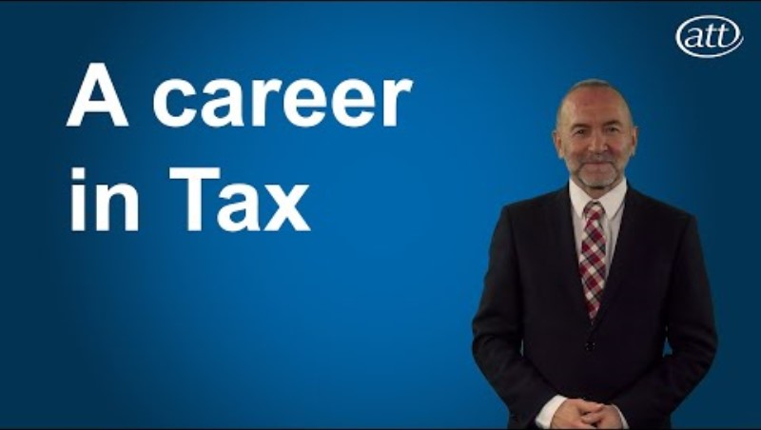



Careers in Finance & Tax
Watch & Discuss
Are you…
Methodical?
Organised?
A good record keeper?
A creative problem solver?
Love maths and numbers?
Do like working with others?
Have empathy and understanding?
Being a good team builder
What do you think to this career?
Do You Like it, Love it or Not Like it?
Give reasons why?

