Slide 1

Career of the Week
Estate Agent
23.09.24

Slide 2
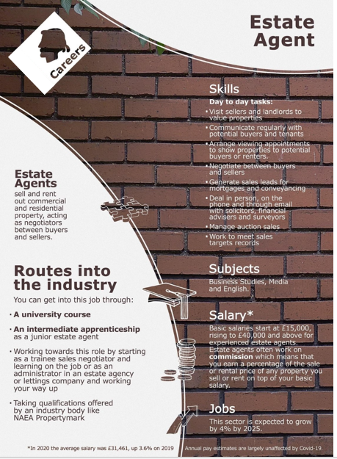



An estate agent also known as a real estate sales agent, will be able to give you an expert view on how much your house is worth, setting it at the right price to the current market. A key part of an estate agent’s job is to manage negotiations and act as a go-between for any potential buyers/renters and the owner of a property. If you are thinking about buying or making an offer on a property, you can ask the estate agent for more information about the position of the owners to gauge the urgency of the sale. Under the property Ombudsman Code of Practice, estate agents must take reasonable steps to find out about the buyer's source and availability of funds for buying the property and pass this information to the seller to start the exchange process.
Types of Estate Agents
You may usually specialise in one area of estate agency, such as:
Residential sales,
Residential lettings
Commercial sales
Commercial lettings
Rural estate.
Work experience – Y10’s, is this an opportunity?
Starting a career in estate agency is relatively straightforward as it's common to find trainee negotiator opportunities where no prior experience is required, and full training is given.
Experience in a related area such as sales, customer service or administration may help your application, as will having good IT skills.
Notes:
Prospects Site Estate agent job profile | Prospects.ac.uk

Slide 3




Here's a video on the role of an Estate Agent
What do you think to this career?
In Netflix Style Do You Like it, Love it or Not Like it?

