Slide 1

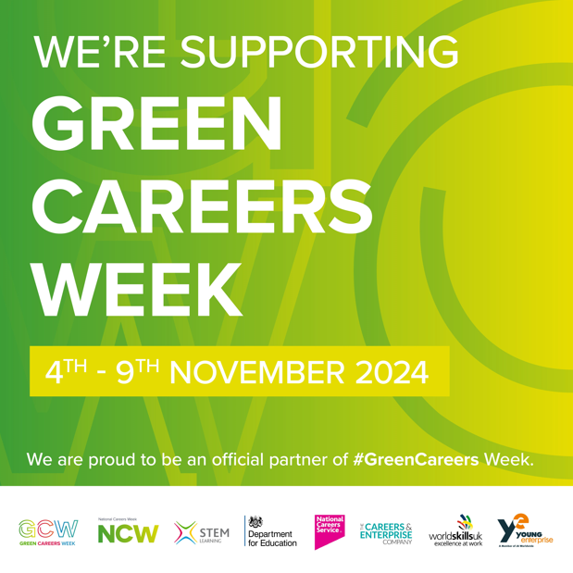
Career of the Week
Environmental Consultant
Notes:
Design and tech, healthcare, aviation Doctor, Police Officer, illustrator, engineer, fashion designer, photographer Chemist, Police, forensics,biologist, tatoo artist, fire fighter, uber driver Stuntman, Food taster, tree surgeon, zookeeper, lawyer, RAF pilot, foster carer, Psychologist (any) - Police - The Beauty Industry - Marketing Industry - Mechanical Engineering Footballers, Lawyers, Bricklaying/ trade work, Astronaut/ work for NASA Astronaut, Therapist, Pediatric Surgeon, Social Worker, Police Officer, Football Referee, Physio, Mechanic, Forensic Psychologist Something to do with the music industry. engineering Catering Engineering Fire fighters, engineering, interior designer, mechanic, detective, lawyer, psychiatrist, footballer, therapist, palaeontologist Lawyer, Cyber Security, Builder, Butcher, Farmer, Chef, Hospitals Sports, Veterinary nursing

Slide 2
Why Green Careers
Diverse Sectors
Growing Demand
Impact Climate Change
Government Support
Skill Development
Economic Benefits
Notes:
Diverse Opportunities: Green careers span a wide range of sectors, including renewable energy, conservation, urban planning, and sustainable agriculture¹².
Growing Demand: The demand for green talent has grown almost 40% in the last seven years, and it’s expected to continue rising as more industries focus on sustainability³.
Impact on Climate Change: Green jobs directly contribute to tackling climate change by increasing energy efficiency, reducing pollution, and conserving natural resources⁴.
Government Support: Many governments, including the UK, have set ambitious targets for creating green jobs to achieve net-zero emissions by 2050¹.
Skill Development: Green careers often require specialized skills and knowledge, leading to opportunities for upskilling and reskilling in various fields³.
Economic Benefits: Investing in green jobs can boost the economy by creating new industries and job opportunities, while also addressing environmental challenges⁴.
Sustainable Future: Green careers are essential for building a sustainable future, ensuring that economic growth does not come at the expense of the environment².
For more information, you can explore these websites:
National Careers Service - Green Careers
BBC News - Green Jobs
World Economic Forum - Green Skills
If you have any specific questions or need further details, feel free to ask! 😊
Learn more
1nationalcareers.service.gov.uk2bbc.co.uk3weforum.org4greenworkx.org

Slide 3
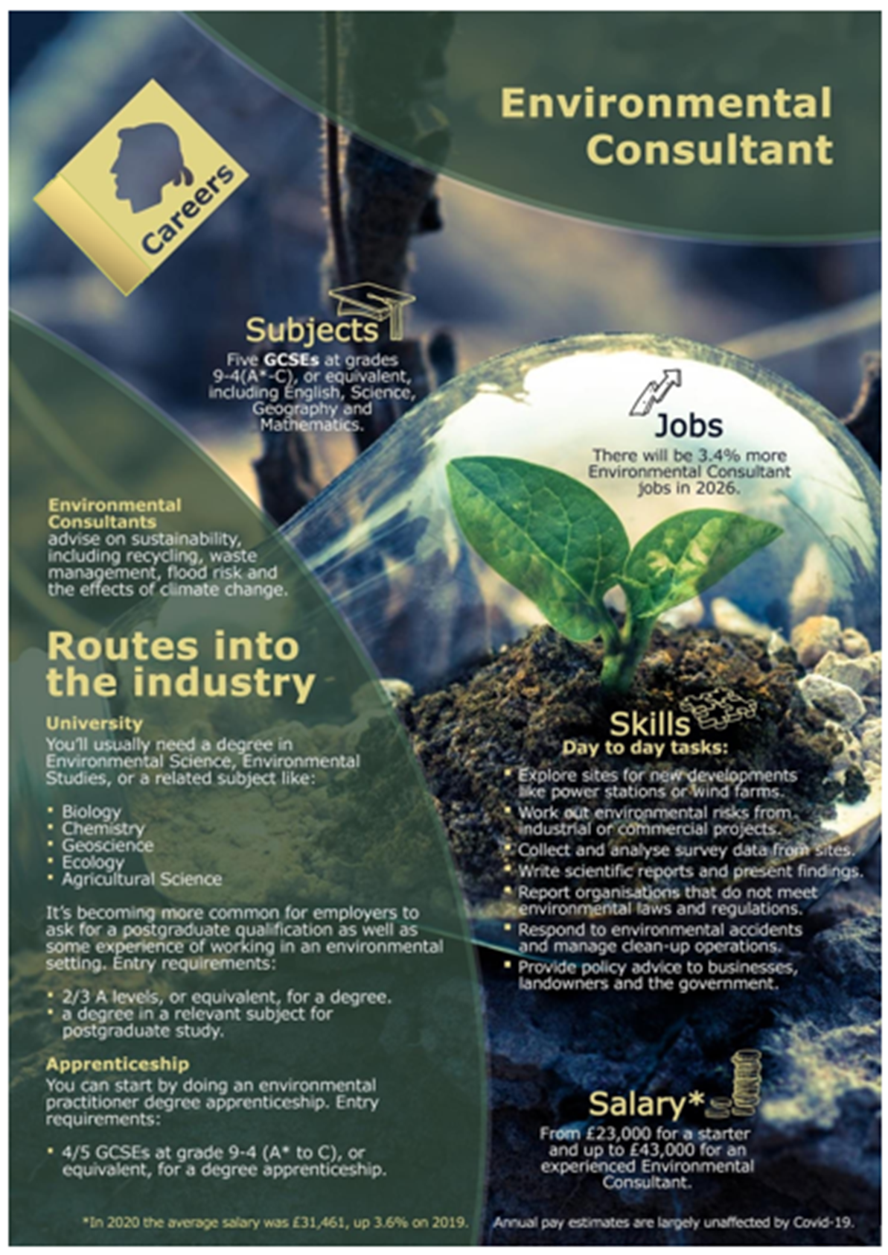
Environmental consulting is often a form of compliance consulting, in which the consultant ensures that the client maintains an appropriate measure of compliance within environmental regulations. Environmental consultants advise on sustainability, including waste management, recycling, flood risk and the effects of climate change.
Organisations who employ these roles are;
Biodiversity Information Service for Powys
Brecon Beacons National Park.
Newt Conservation Partnership.
Dalcour Maclaren.
Dartmoor Preservation Association.
Bluedot Associates.
Ecological Restoration Fund.
HalpinRobbins.
Quantock Ecology Ltd.
For more information, you can explore these websites:
National Careers Service - Green Careers
BBC News - Green Jobs

Slide 4
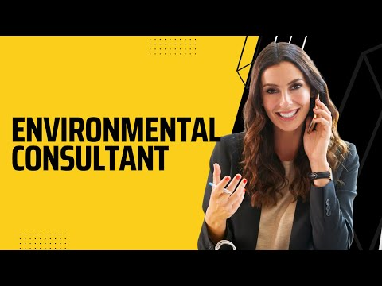



Here's a video on the role of an Environmental Consultant
What do you think to this career?
In Netflix Style Do You Like it, Love it or Not Like it?

