Slide 1

Career of the Week
Design &
Development Engineer
Notes:
Design and tech, healthcare, aviation Doctor, Police Officer, illustrator, engineer, fashion designer, photographer Chemist, Police, forensics,biologist, tatoo artist, fire fighter, uber driver Stuntman, Food taster, tree surgeon, zookeeper, lawyer, RAF pilot, foster carer, Psychologist (any) - Police - The Beauty Industry - Marketing Industry - Mechanical Engineering Footballers, Lawyers, Bricklaying/ trade work, Astronaut/ work for NASA Astronaut, Therapist, Pediatric Surgeon, Social Worker, Police Officer, Football Referee, Physio, Mechanic, Forensic Psychologist Something to do with the music industry. engineering Catering Engineering Fire fighters, engineering, interior designer, mechanic, detective, lawyer, psychiatrist, footballer, therapist, palaeontologist Lawyer, Cyber Security, Builder, Butcher, Farmer, Chef, Hospitals Sports, Veterinary nursing

Slide 2
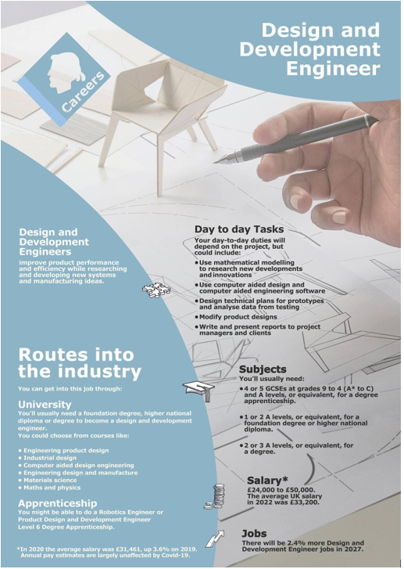
CAREERS IN ENGINEERING – KEY FACTS
There has been a shift in growing areas like IT, Health & Beauty and Service based industries for design and development roles.
One of the highest in demand careers in the UK.
There is a skills gap in the UK for technical and digital skills, which creates an opportunity for those with software and computer science capability.
Women are increasing their representation in these role moving from 10.5% in 2010 to 16.5 in 2021 – more room for progress!.
Significant opportunities across the East, West Midlands and the North-East.
Some great subject mixes at GCSE or A Level
Physics
Design & Tech
Art
Maths
Chemistry
Product Design
Computer Science
English
Notes:
LMI FACTS
Growth: Employment in engineering occupations, including design and development roles, grew by 8.5% between 2010 and 2021¹.
Sector Shifts: There has been a shift from traditional manufacturing and construction to service-based industries like information and communications¹.
Demand and Skills
High Demand: Development engineers are among the roles with the highest demand across the UK².
Skills Gap: There is a notable skills gap, particularly in development engineering, which requires a strong knowledge of software and computer sciences².
Diversity and Inclusion
Gender Diversity: The proportion of women in engineering roles has increased from 10.5% in 2010 to 16.5% in 2021¹.
Ethnic Diversity: The ethnic diversity of the engineering workforce has also risen, with 11.4% of engineers being from ethnic minority backgrounds in 2021¹.
Salary and Working Conditions
Average Pay: Salaries for design and development engineers vary by region and experience. Starting salaries typically range from £20,000 to £25,000, with experienced engineers earning between £30,000 and £55,000³.
Working Hours: Engineers usually work 37 to 40 hours per week, with some flexibility depending on the employer³.
Regional Variations
Employment Distribution: Engineering jobs are spread across the UK, with significant concentrations in regions like the East and West Midlands, and the North East¹.
Regional Pay Differences: Salaries can vary significantly by region, with higher pay often found in London and the South East³.
Future Outlook
Continued Demand: The demand for design and development engineers is expected to remain strong, driven by ongoing technological advancements and the need for innovation².
If you need more specific information or have any other questions, feel free to ask!
SUBJECT CHOICES
Mathematics - Essential for developing problem-solving skills and understanding engineering principles.
Physics - Provides a fundamental understanding of forces, energy, and materials.
Design and Technology - Offers practical skills and knowledge in designing and making products.
Computer Science - Useful for understanding software and programming, which are increasingly important in engineering.
Chemistry - Beneficial for understanding materials and their properties.
A Level
Mathematics - Critical for all engineering disciplines, covering advanced topics like calculus and algebra.
Physics - Essential for understanding the principles that underpin engineering.
Design and Technology - Focuses on the application of scientific principles and mathematical calculations to solve real-world problems¹.
Further Mathematics - Highly recommended for those aiming for top engineering universities.
Computer Science - Important for roles involving software development and digital systems.
Chemistry - Useful for certain engineering fields like chemical or materials engineering.
Additional Recommendations
Art or Graphic Design - Can be beneficial for developing creativity and design skills.
Engineering - Some schools offer specific engineering courses at GCSE or A level, which provide a direct introduction to the field².
These subjects will help you build a strong foundation in both the theoretical and practical aspects of engineering. If you have any more questions or need further guidance, feel free to ask!

Slide 3





Here’s two short video’s on the role of a Product Development & Design Engineer
What do you think to these type of careers?
In Netflix Style Do You Like it, Love it or Not for You?

