Slide 1



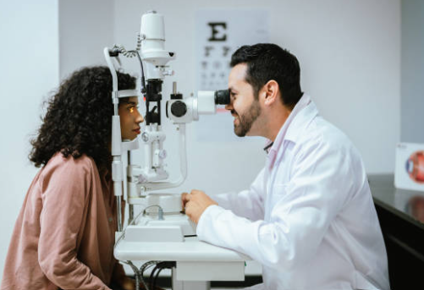
Careers in Healthcare
Career of the Week
Optometrist

Slide 2
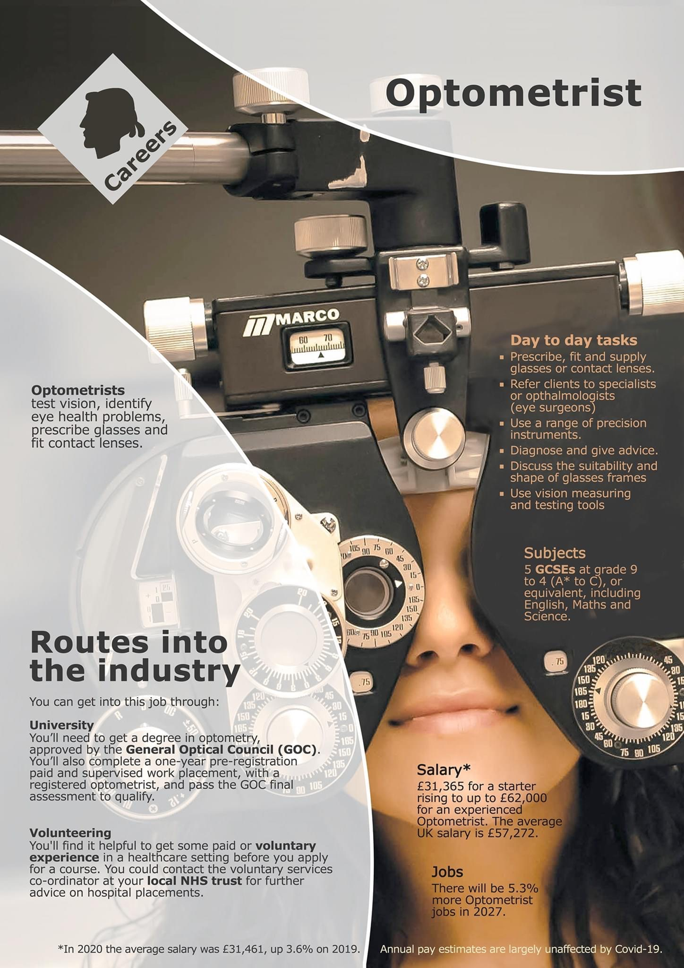
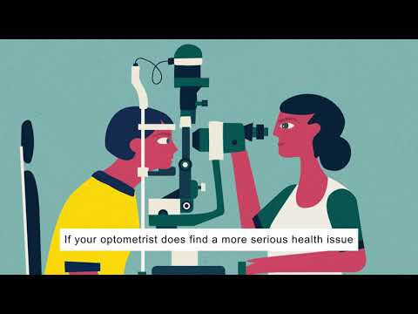
Previously known as opticians, optometrists are trained to examine the eyes to detect defects in vision, signs of injury, ocular diseases or abnormality and problems with general health, such as high blood pressure or diabetes. They make a health assessment, offer clinical advice, prescribe spectacles or contact lenses and refer patients for further treatment, when necessary.
Watch The Video - What is the role of an Optometrist?

Slide 3
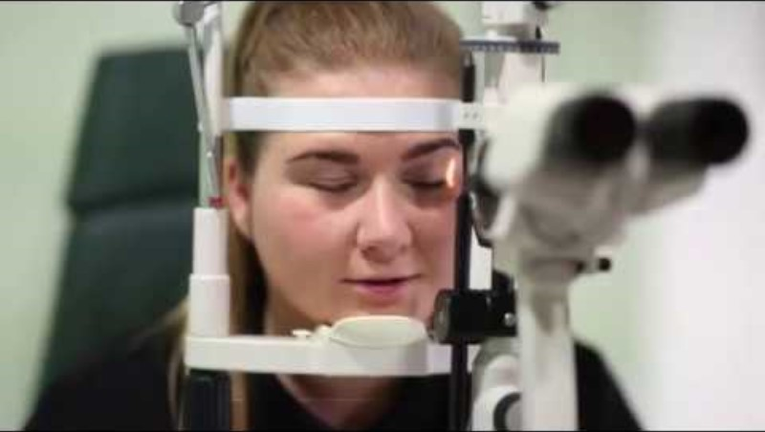



Careers in Optometry….
Listen to the Team at Specsavers hear about their career choices and why they chose Optometry
Watch & Discuss
What do you think to this career?
Do You Like it, Love it or Not Like it?
Give reasons why?

