Slide 1

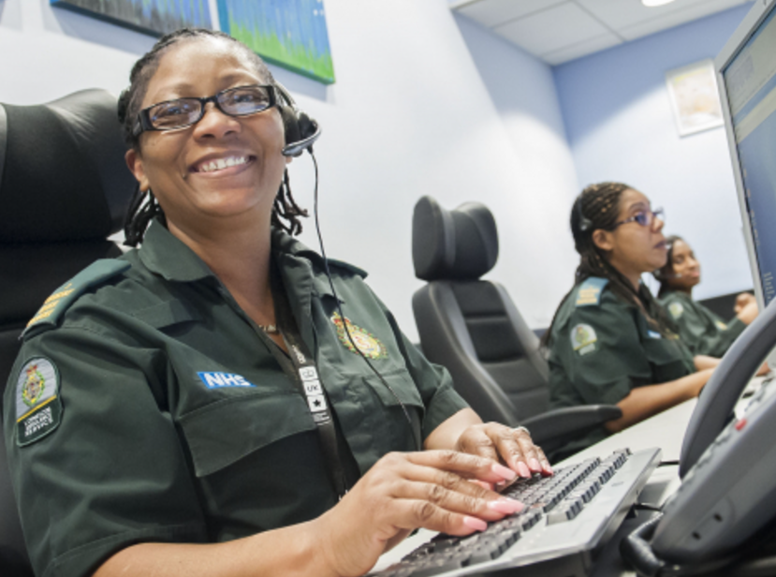
Careers In Healthcare
Career of the Week
Emergency Call Handler

Slide 2
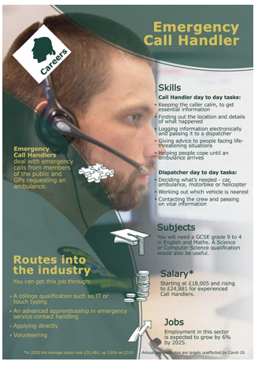
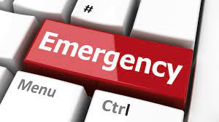
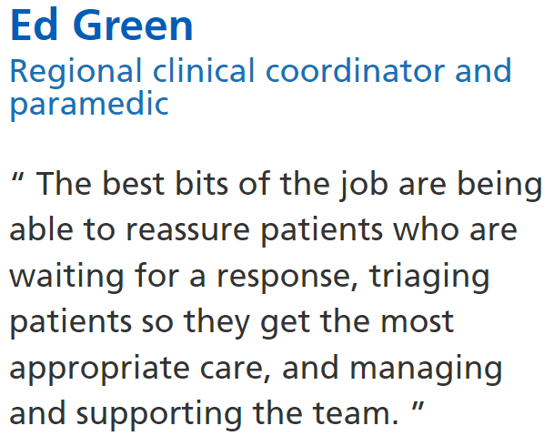

Call handlers and emergency medical dispatchers work in ambulance control rooms as part of a team. In most ambulance trusts, call handler and the dispatcher are separate roles, but some trusts combine them. Working quickly and calmly, call handlers take essential details about the patient's condition and location, logging the information onto a computer system, allowing them to provide the relevant support.
Read his story here Real-life story - Ed Green | Health Careers
Notes:
Real-life story - Ed Green | Health Careers

Slide 3




Here’s a short clip on the role of an Emergency Call Handler
Group Discussion
What do you think to this job and why?
In Netflix Style Do You Like it, Love it or Not Like it?

