Slide 1


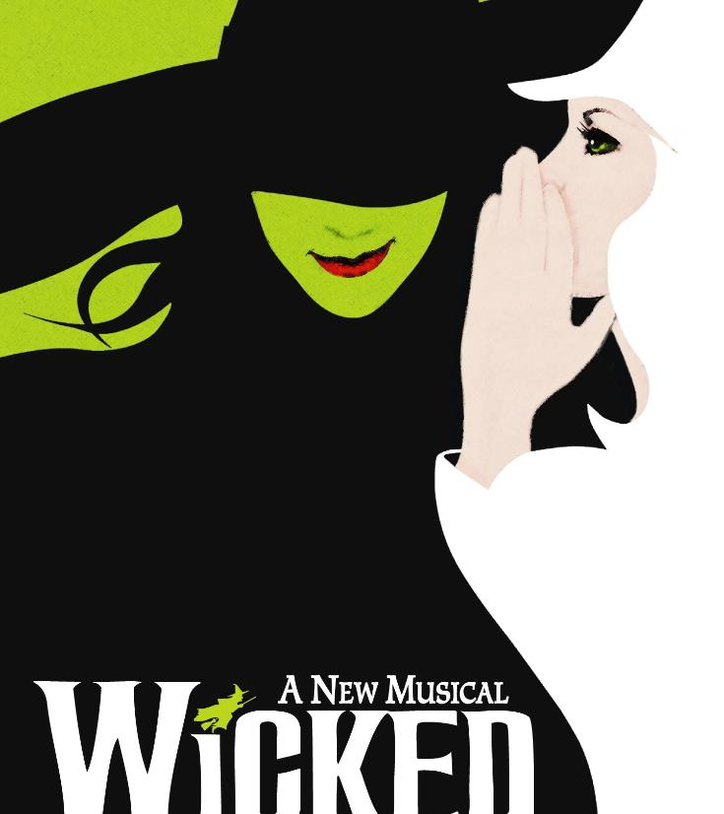
Careers in Crafts, Fashion and Textiles
Career of the Week
Costume Designer
#CreativeCareersWeek
Notes:
Design and tech, healthcare, aviation Doctor, Police Officer, illustrator, engineer, fashion designer, photographer Chemist, Police, forensics,biologist, tatoo artist, fire fighter, uber driver Stuntman, Food taster, tree surgeon, zookeeper, lawyer, RAF pilot, foster carer, Psychologist (any) - Police - The Beauty Industry - Marketing Industry - Mechanical Engineering Footballers, Lawyers, Bricklaying/ trade work, Astronaut/ work for NASA Astronaut, Therapist, Pediatric Surgeon, Social Worker, Police Officer, Football Referee, Physio, Mechanic, Forensic Psychologist Something to do with the music industry. engineering Catering Engineering Fire fighters, engineering, interior designer, mechanic, detective, lawyer, psychiatrist, footballer, therapist, palaeontologist Lawyer, Cyber Security, Builder, Butcher, Farmer, Chef, Hospitals Sports, Veterinary nursing

Slide 2
Why a Creative Career?
Diverse Sectors
Growing Demand
Variety
Flexibility
Skill Development
Mental Health
Notes:
Benefits of Creative Careers
Sure! Here are the top 6 benefits of having a creative career:
Personal Fulfillment: Engaging in creative work allows you to express yourself and pursue your passions, leading to greater job satisfaction and personal fulfillment¹.
Variety and Flexibility: Creative careers often offer a variety of tasks and projects, ensuring that no two days are the same. Many creative roles also provide flexible working hours and environments¹.
Collaboration Opportunities: Working in a creative field often involves collaborating with other like-minded individuals, which can be both inspiring and enriching¹.
Mental Health Benefits: Having a creative outlet can reduce stress and support overall mental well-being. It helps in maintaining a healthy mind by providing a way to process emotions and experiences¹.
Job Security: Creativity is a highly valued skill across many industries, leading to a higher demand for creative professionals. This can translate to better job security¹.
Continuous Learning and Growth: Creative careers often require you to stay updated with new trends, tools, and techniques, fostering continuous learning and professional growth¹.
Does any of these benefits resonate with you?
Learn more
1productsofdesign.sva.edu2themuse.com3bing.com4insightglobal.com5britishstylesociety.uk6coursera.org

Slide 3
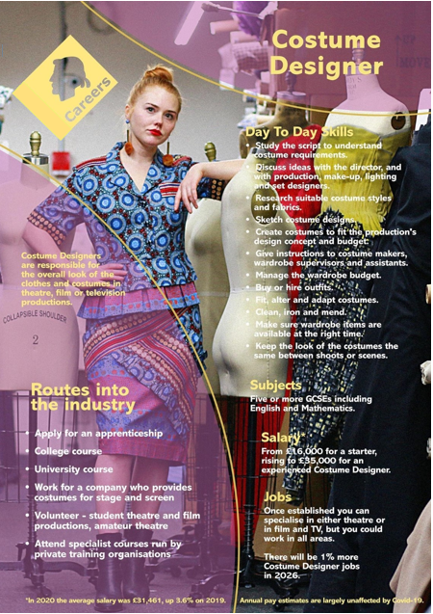
Costume design is the creation of clothing for the overall appearance of a character or performer. Costume may refer to the style of dress particular to a nation, a class, or a period.
In many cases, it may contribute to the fullness of the artistic, visual world which is unique to a particular theatrical or cinematic production. The most basic designs are produced to denote status, provide protection or modesty, or provide visual interest to a character.
Costumes may be for a theatre, cinema, musical performance, parties, or other events. Costume design should not be confused with costume coordination which merely involves altering existing clothing, although both create stage clothes.
There are four types of costumes that are used in theatrical design: Historical, Fantastical, Dance, and Modern.
3m+ people work in creative industries – 1 in 11 jobs across the UK
87% of creative jobs are at low or no risk of automation

Slide 4

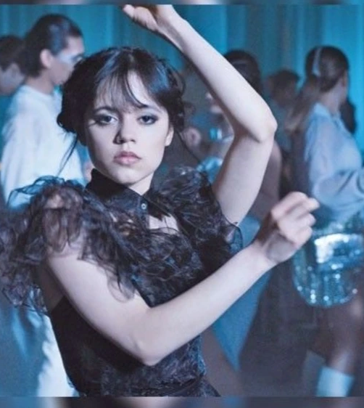
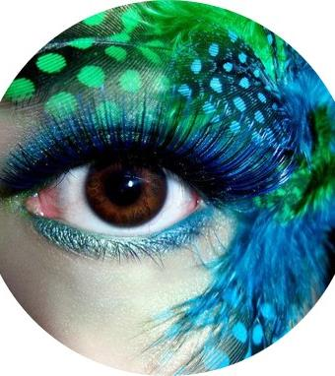
Meet costume designer, Alice Buckingham
Alice has to be aware and have knowledge of many other aspects while buying or designing costumes
The Creative Director’s vision
Costume Research
Costume Maker & Pattern Cutters
Wardrobe Supervisor & Wardrobe Assistant
Make Up Artist
Prop Maker & Set Designer and Maker
The Film Crew & Lighting

Slide 5




Here’s another short slip on her role as a Costume Designer
Alice’s job encompasses the knowledge of lots of other roles in the film, TV & theatre industry
Group Discussion
What do you think to this career and why?
In Netflix Style Do You Like it, Love it or Not Like it?

Slide 6
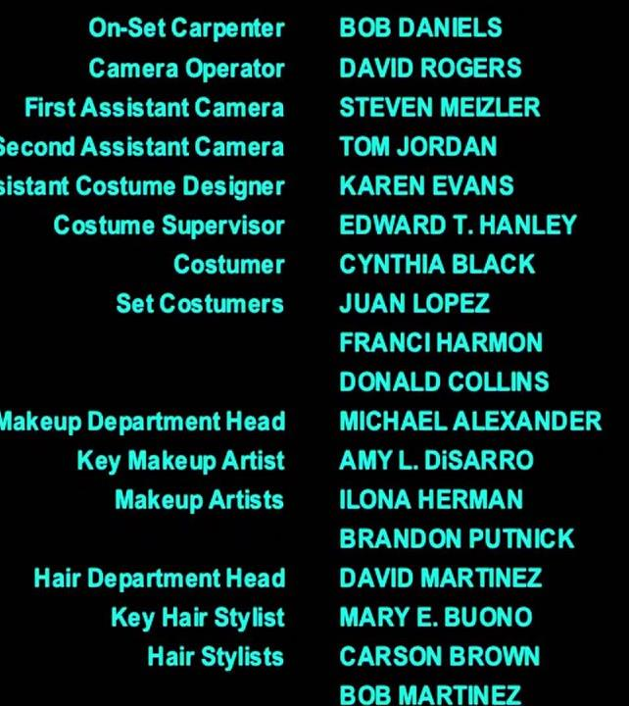
Activity Creative Careers – Roll Credits
How many of these roles have you heard of?
Have you seen these roles on the credits after a movie?
What role could you see yourself doing and why?

