Slide 1

Career of the Week
Exotic Veterinarian
21.10.24

Slide 2
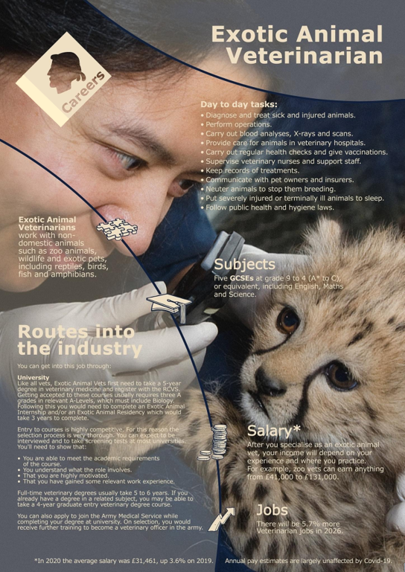
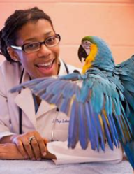
Types of Exotic Animal Veterinarians
Q – Who has had an exotic pet? What type and what was this like taking care of it?
Here is an overview of specialized exotic animal vets:
Avian – Specializing in the care of birds, including both pet birds and those in aviaries or zoos, these veterinarians may treat common pet bird species, such as parrots, as well as exotic and wild bird species.
Reptile and Amphibian – Focusing on the health and medical care of reptiles and amphibians, including snakes, turtles, lizards, frogs, and salamanders, these vets, also known as herpetological veterinarians, are knowledgeable about the unique physiological and environmental needs of these animals.
Zoo – As the name implies, these veterinarians work in zoos and wildlife parks, providing medical care to a wide range of exotic animals, including mammals, birds, reptiles, and amphibians. They often collaborate with other professionals to manage the health and wellbeing of animals in captivity.
Aquatic – These vets specialize in the care of aquatic animals, including fish, marine mammals, and amphibians that live in aquatic environments. They may work in aquariums, marine parks, or research institutions.
Wildlife – Focusing on the health and conservation of wild animals, including those in rehabilitation centres, sanctuaries, or involved in conservation projects, wildlife veterinarians may work with a variety of species to address both individual and population health.
Exotic Pet – These vets work in general veterinary practices that specifically cater to exotic pets, which can include a variety of small mammals, birds, reptiles, and invertebrate.
Small Mammal– Focusing on the medical care of small mammals, such as ferrets, rabbits, guinea pigs, and hedgehogs, small mammal vets may work in general practices or specialize in exotic pet care.
Skills – What’s needed to become an exotic Veterinarian?
Knowledge of the animal
Anatomy, physiology of diseases
Able to handle animals safely
Medical training for animals
Communication
Calm under pressure

Slide 3




Here's a video on the role of an Exotic Veterinarian?
What do you think to this career?
In Netflix Style Do You Like it, Love it or Not Like it?

