Slide 1

Career of the Week
Paranormal Investigator
14.10.24

Slide 2
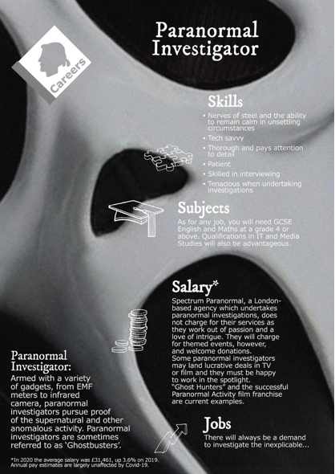
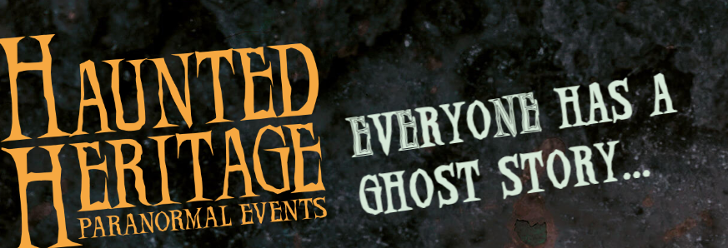

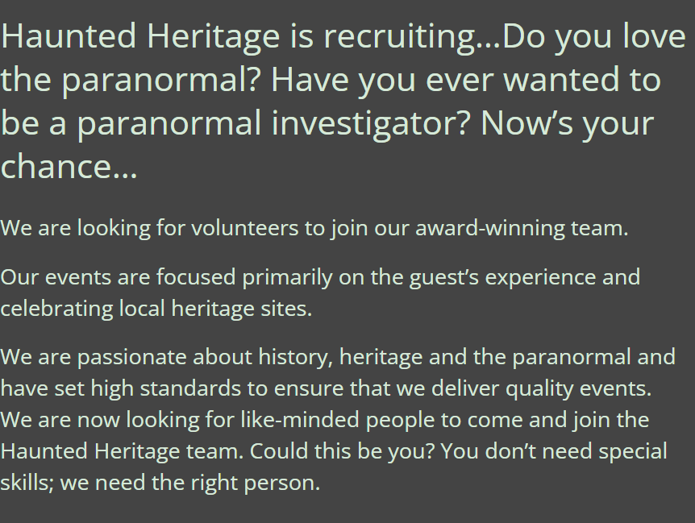
Ghost hunting is the process of investigating locations that are reported to be haunted by ghosts. Typically, a ghost-hunting team will attempt to collect evidence supporting the existence of paranormal activity. Ghost hunters use a variety of electronic devices, including EMF meters, digital thermometers, both handheld and static digital video cameras, including thermographic and night vision cameras, night vision goggles, as well as digital audio recorders.
Other more traditional techniques are also used, such as conducting interviews and researching the history of allegedly haunted sites. Ghost hunters are also known as paranormal investigators.
Do you fancy getting some work experience, are you the next Mulder or Scully from the X files?? Look no further, check out this website, who are looking for willing victims or should I say volunteers…..
Notes:
Website details Team Recruitment - Haunted Heritage

Slide 3




Here's a video on the role of a Paranormal Investigator
What do you think to this career?
In Netflix Style Do You Like it, Love it or Not Like it?

