Slide 1

Career of the Week
Medical Illustrator
30.09.24

Slide 2
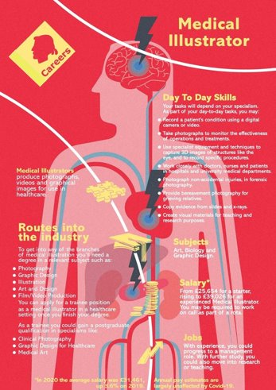
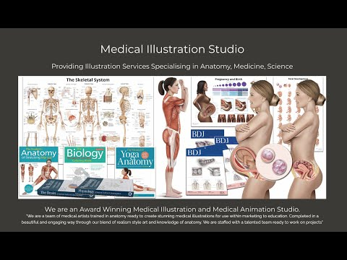
Medical illustration is a specialist area of work made up of clinical photographers, medical videographers, medical graphic designers and medical artists. These roles support other healthcare professions and fall under the umbrella term healthcare scientist.
The images you create, as a medical illustrator, are used in patient care, teaching, education and research. Advanced technical ability and an understanding of anatomy are needed.
Because illustrators can visualise ideas and stories, they may find work in other diverse industries, including businesses where they work as part of a marketing or advertising team.

Slide 3
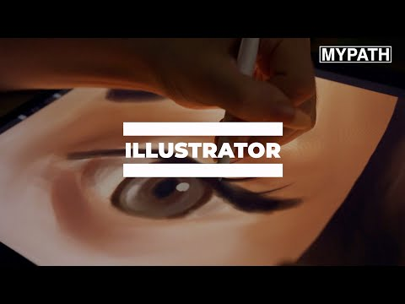



Here's a video on the role of a Medical Illustrator
What do you think to this career?
In Netflix Style Do You Like it, Love it or Not Like it?

