Slide 1

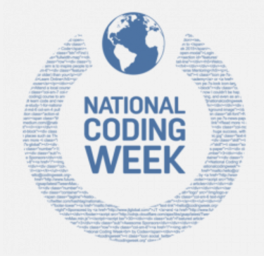
#nationalcodingweek
Career of the Week
App Developer
16.09.24
Notes:
Home - National Coding Week

Slide 2
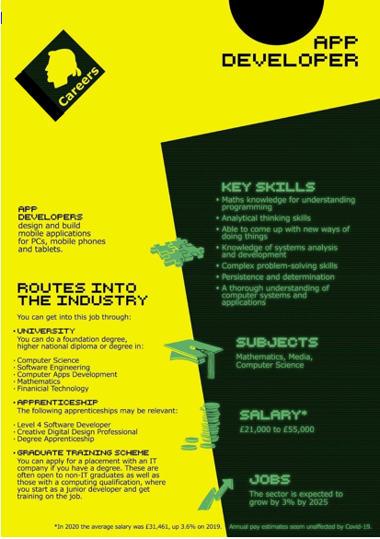
Careers in Science, Digital & Technology
A growing professional career being in the middle of a technology revolution.
Science and technology is a diverse career field that generally involves scientific research and the development of innovative technologies that benefit humanity. Scientific professions often involved some degree of mathematics or computer science knowledge.
An App Developer is a computer software engineer whose primary responsibilities include creating, testing and programming apps for computers, mobile phones, and tablets. These developers typically work in teams and think of ideas and concepts either for the public, or for a specific customer need. App developers understand coding languages and how to use them, and may also work alongside graphic artists, data scientists, and other software experts to create applications. They also test and fix any bugs that are found before the product is launched.
Mobile app development is the act or process by which a mobile app is developed for mobile devices, such as personal digital assistants, enterprise digital assistants or mobile phones. These software applications are designed to run on mobile devices, such as a smartphone, tablet or computer.
Academy Careers Advisor – Mrs Jane

Slide 3




Here's a video on the role of an App Developer
What do you think to this career?
In Netflix Style Do You Like it, Love it or Not Like it?
Notes:
Lets hear from a 12 year old app developer: https://youtu.be/Fkd9TWUtFm0
More information on coding will be communicated by class charts if you’re interested in pursuing this type of career.
Home - National Coding Week

