Slide 1

Career of the Week
Hydrologist

Slide 2
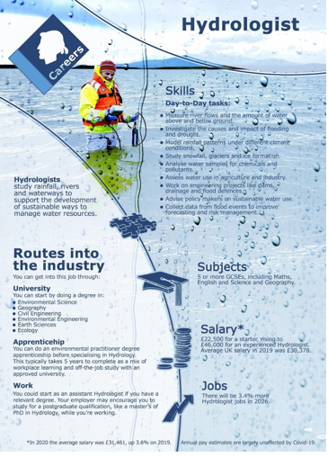
Hydrologist V Hydrogeologist.
Hydrologists are involved in the monitoring, management and protection of water and water resources in commercial, environmental and academic settings.
They ensure the effective flow of water through channels and pipes for the engineering and control of water provision.
A hydrogeologist is a person who studies the ways that groundwater (hydro) moves through the soil and rock of the earth (geology). A similar profession, a hydrologist, is someone who studies surface water.
Geology is the study of how the Earth changes through time. Hydrology is the study of water systems and water movement throughout the Earth.
Typical employers include:
Water supply companies - see Water UK for details of water and sewerage operators
Utility companies and public authorities that provide water and sewerage services
Government and environmental bodies, including the Environment Agency (EA), regional councils, the Scottish Environment Protection Agency (SEPA) and the Northern Ireland Environment Agency (NIEA)
Consultancies, including civil engineering and environmental management and assessment companies
Research and development agencies, including the Centre for Ecology & Hydrology (CEH) - part of the Natural Environment
The Natural Environment Research Council (NERC) and the Water Research Centre (WRC) Group
Educational institutions that undertake relevant teaching and research.
Notes:
Notes for Info
12 Captivating Facts About Hydrologist - Facts.net
Hydrologist job profile | Prospects.ac.uk

Slide 3
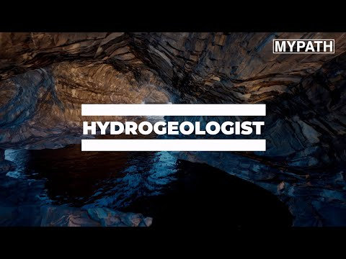
Here's a video on the role of a Hydrologist

