Slide 1

Career of the Week
Farmer

Slide 2
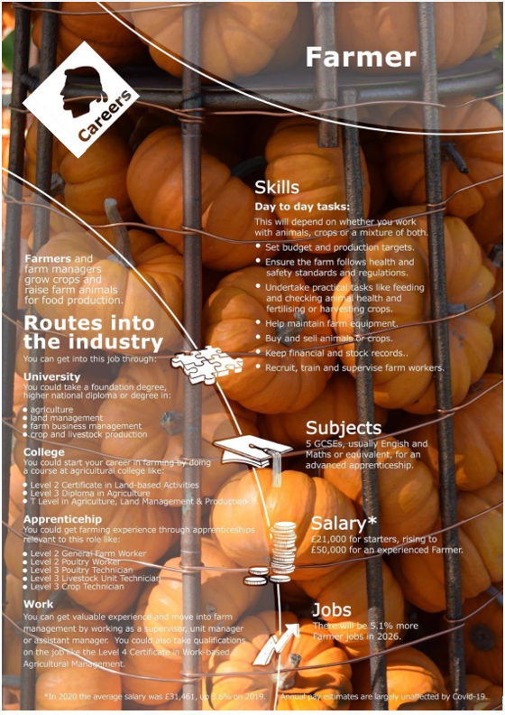
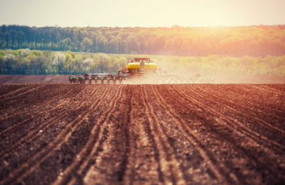
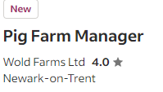

Careers in Agriculture – The Best Bits
High employment rates, 96% of graduates are employed within 6 months of graduating.
Labour shortage, a growth in environmental careers shows a need for 60,000 new workers, plenty of job opportunities.
Scenic work locations, allows you to live and work in some of the most beautiful countryside.
Long term prospects, as populations grow, food production remains essential.
Average salaries exceed national average.
Diverse roles, from farming, engineering, researcher, trader plus much more roles.
Do you like……
Working with animals?
Working outdoors?
Solving problems?
Making a difference the world you live in?
What are some local opportunities?
Notes:
HPA 22.07.24
Certainly! Here are some compelling reasons to consider a career in agriculture in the UK:
Great Employment Rates: Graduates from institutions like Harper Adams University have a 96% employment rate within six months of graduating¹.
Labour Shortage: The industry estimates a need for 60,000 new workers by 2020, making it an area with ample job opportunities.
Scenic Work Locations: Agriculture allows you to live and work in some of the most beautiful countryside areas.
Long-Term Prospects: As global populations grow, food production remains essential, ensuring stable prospects.
Surprising Pay: Average salaries in agriculture exceed the national average¹.
Diverse Roles: Beyond farming, you can work as an engineer, scientist, researcher, business advisor, trader, manager, retailer, or vet¹.
Remember, you don’t need a farming background to thrive in this field! 🌾🚜🌿²³
Learn more
1fwi.co.uk2agrirs.co.uk3agrirs.co.uk

Slide 3
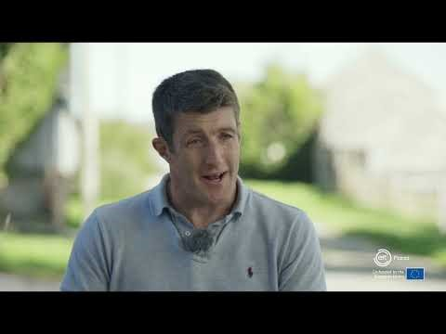


Here's a video showing you more about the job of a Farmer
Would you enjoy a job like this?

