Slide 1

Career of the Week
Animal Care Attendant

Slide 2
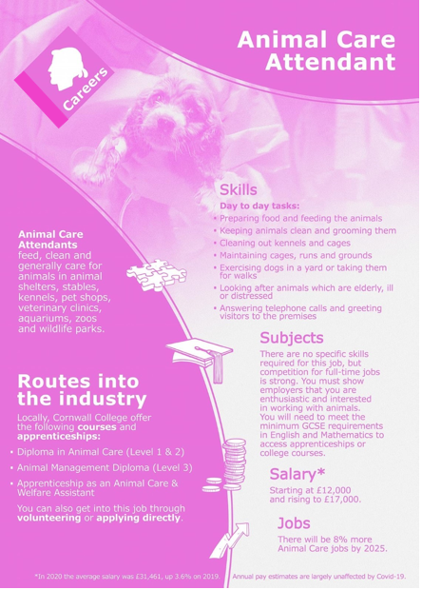



If you love observing, studying or treating animals, there are many career paths which may be suitable for you. Working with animals can be a fulfilling job but can also be physically and mentally demanding. Most careers involve hands-on job duties, in which you may treat, train or clean a variety of animals. You may choose to focus on a specific kind or group of animals.
Experience the day in the life of an animal care attendant looking after dogs.....
https://youtu.be/qlwvi-Cpk7Q
Where could you find job opportunities to start work?
Academy Careers Advisor – Mrs Jane

Slide 3
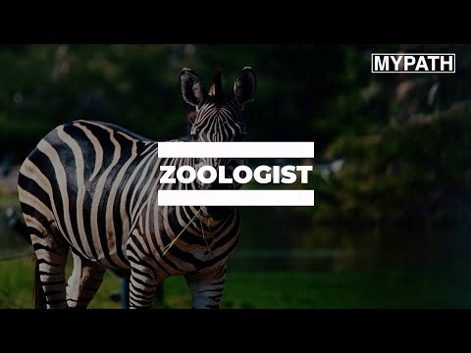


Here's a video showing you more about the role of an animal care attendant
Would you enjoy a job like this?

