Slide 1

Career of the Week
Sports Journalist

Slide 2
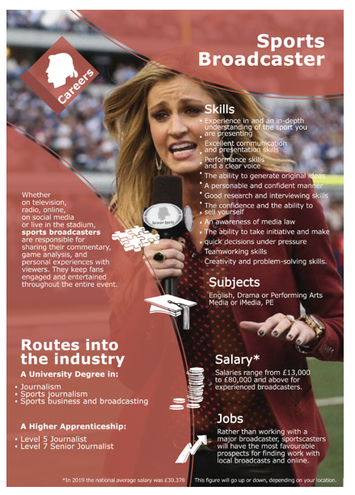




The broadcasting of sports events (also known as a sportscast) is the live coverage of sports as a television program, on radio, and other broadcasting media. It usually involves one or more sports commentator's describing events as they happen.
The FIFA World Cup was first broadcasted on television in 1954 and is now the most widely viewed and followed sporting event in the world, exceeding the Olympic Games. In history over 700 million individuals have tuned in to watch the tournament.
Which sports broadcasters spring to mind? Which ones do you like? Why?
There are many different roles in media, such as;
Editor
Reporter
Presenter
Correspondent
To get into this type of work, think about how the companies in the East Midlands and how you get valuable work experience for a few days. Here are some local radio stations which is one channel…..
BBC Radio Nottingham | Capital FM | ITV News Central
Academy Careers Advisor – Mrs Jane
Notes:
08.07.24

Slide 3



Here's a video showing you more about the role of a Sports Broadcaster and what’s skills are needed
Would you enjoy a job like this?

