Slide 1

Career of the Week

Slide 2
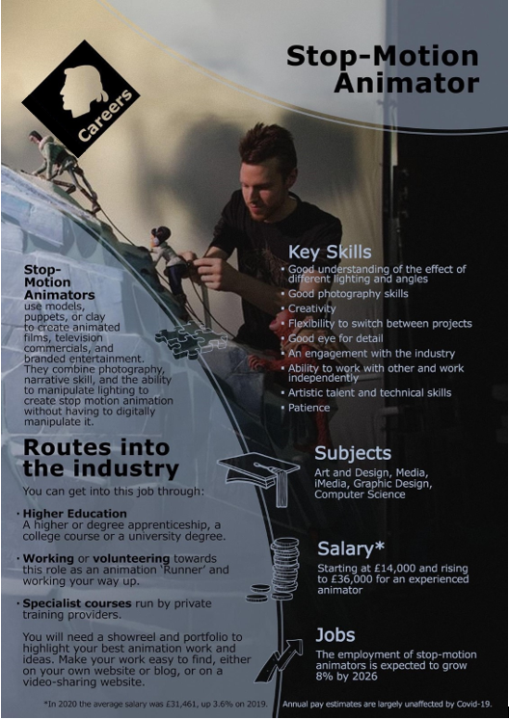







Careers in Animation
What to expect
Animation is an office or studio-based profession. Some experienced freelancers have studio equipment set up at home.
It's a global industry and many projects are for international clients. Most production companies have a list of animators they use, so maintaining regular contact will prevent you from slipping off their list.
The animation industry is global, but there are regional UK centres based in London, Bristol, Manchester, Dundee and Edinburgh.
Overseas and UK travel may be necessary to showcase your work at festivals or to negotiate commissions with clients.
The UK also leads the world in the production of pre-school storytelling and design, and this area continues to attract investors, ensuring the availability of work.
Employers may be independent filmmakers or organisations employing freelancers or permanent contracts, companies like Lego, BBC, Channel 4, Warner Bros, Rocksteady, Google, Walt Disney to name a few.
Notes:
Oakwood 01.0
https://www.indeed.com/career-advice/finding-a-job/how-to-become-stop-motion-animator

Slide 3



Here's a video showing you more about the role of a Stop Animator for Lego
Would you enjoy a job like this?

