Slide 1
Career of the week

Slide 2
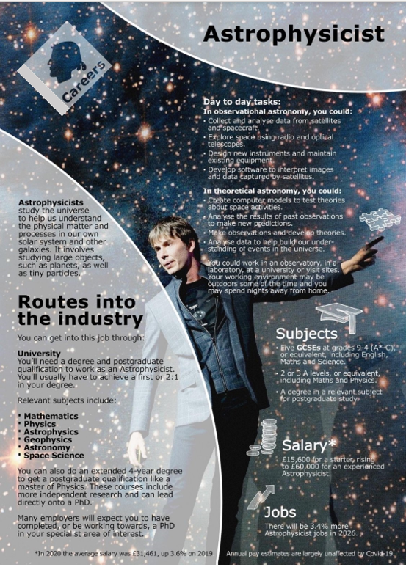

Fun Facts About the Universe…Did you know?
# 1. Even though the universe is always expanding, our galaxy and our closest galaxy are actually on a collision course, where they will eventually form one larger galaxy. And then, again over millions of years will split apart and move away from each other.
# 2. Scientists estimate that there as many Stars in the Universe as there are grains of sand on all the beaches on earth.
# 3. A black hole absorbs everything that crosses it because of its huge gravitational pull...even light!
# 4. Asteroids are small bodies of rock or metal which orbit the sun. They are thought to be leftover remnants from the creation of our solar system 4.6 billion years ago. Most of the asteroids in our solar system are found in the "asteroid belt", which is roughly located between Mars and Jupiter.
#5. Because gravity is so low, astronauts are not able to burp! The liquid in their stomach cannot separate from gases.
Who was the first human being to visit space?
Yuri Gagarin from the Soviet Union 1961
Notes:
Google https://www.nasa.gov/image-article/april-1961-first-human-entered-space/#:~:text=Yuri%20Gagarin%20from%20the%20Soviet,the%20flight%20lasting%20108%20minutes
Yuri Gagarin from the Soviet Union was the first human in space. His vehicle, Vostok 1 circled Earth at a speed of 27,400 kilometers per hour with the flight lasting 108 minutes.

Slide 3

Become an Astrophysicist
Is this a career and job you’d like to get into?
Notes:
https://www.youtube.com/watch?v=T-X4rMu6usI

