Slide 1

Career of the Week

Slide 2
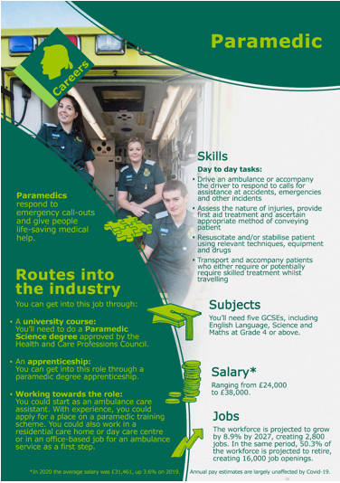
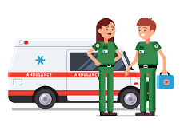
People often use the term "paramedic" for anyone who works on an ambulance. However, not all ambulance crew have paramedic as their job title. "Emergency Medical Technicians" or "Emergency Care Assistants" do similar work but sometimes have less training.
What you’ll do as a Paramedic?
Day-to-day tasks involve….
Respond to emergency calls.
Assess situations when you arrive and check details with others at the scene, like the police.
Work calmly and quickly to stabilise patients.
Use a defibrillator to revive patients.
Give patients medicines and injections.
Help to deliver babies.
Attend non-emergency calls and decide whether patients need to go to hospital.
Check equipment regularly and keep accurate records.
Reassure family and members of the public who are on the scene.

Slide 3
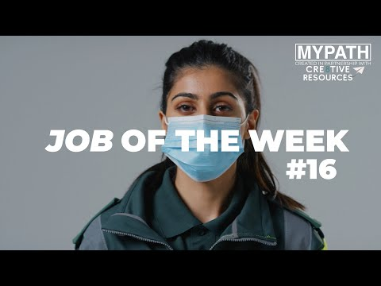
Watch a Video
Paramedic A Day in Life
Would you like to have a career as a Paramedic?
Notes:
Peter – can you download the video and add

Slide 4

https://forms.office.com/e/Seai25cQmq
Notes:
Please as your tutor group what careers/jobs they would want to know more about and we’ll profile these

