Slide 1

Career of the Week

Slide 2
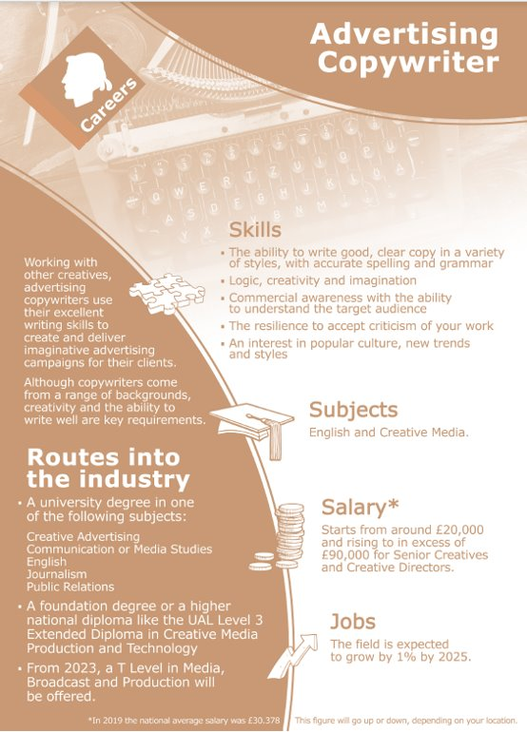
Employers
This is a career high in demand
Copywriters mainly work for advertising or full-service marketing agencies.
There are also specialist agencies that focus on specific areas such as digital advertising, with more than 250 member agencies.
Newspapers often employ copywriters to write advertisements, as do radio stations to write jingles.
Medical copywriting for pharmaceutical companies is also an option for those with a medical or science degree.
Copywriting goes across all industries.

Slide 3

Would you like to be a creative copywriter?

Slide 4
Submit your Suggestions for Career of the Week
Notes:
Please as your tutor group what careers/jobs they would want to know more about and we’ll profile these

