Slide 1

Career of the Week
Ofsted Inspector

Slide 2

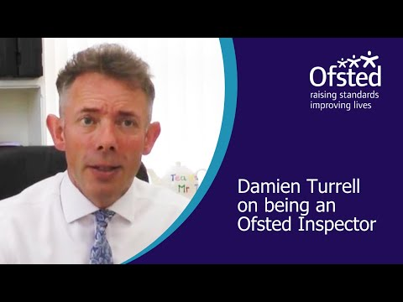
Ofsted is the Office for Standards in Education and Children’s Services. Ofsted inspectors (OI's) inspect and regulate services that care for children and young people, and the services providing education for learners of all ages. Hundreds of inspections and regulatory visits take place throughout England every week and the results are published online.
The inspections are carried out by teams of Ofsted accredited independent inspectors, led by a Registered lead Inspector. They often vary in size from a minimum of three up to about eight per inspection. Only people with appropriate experience and training are allowed to participate in inspections.
Is this a job you’d like to do in the future?

