Slide 1

Career of the Week
Notes:
HPA – 17 June 2024

Slide 2
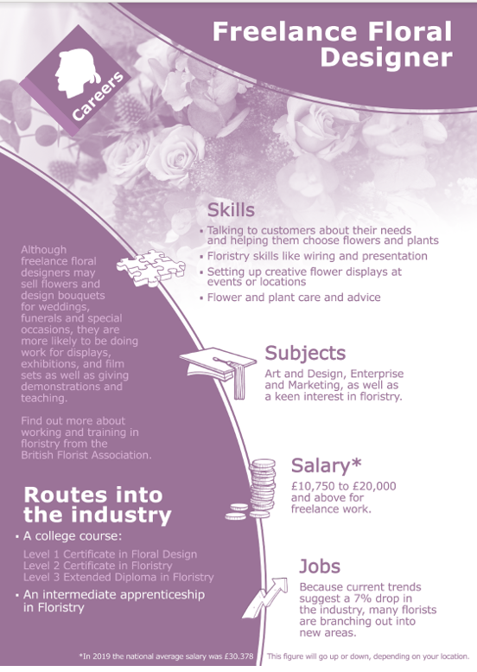


Freelance means
self-employed and hired to work for different companies on particular assignments.
What educational qualifications are required?
Consider taking a florist-related college course. Depending on your course, you may need five or fewer GCSEs, especially in mathematics and English, to qualify. Many colleges offer accredited floristry courses, while some are specialist horticultural colleges with training facilities.
Key skills
Customer service
Creativity
Communication
Time Management
Organisation
Flower & Plant
knowledge
Career Progression and Linked Jobs
Junior Florist – upto £14,000
Florist – upto £24,000
Store Manager – upto £30,000
Floral designer – upto £40,000
Garden keeper – upto £24,000
Garden Centre Manager – upto £25,000

Slide 3



Here's a video of the best bits of being a Florist….
Would you enjoy a job like this?

