Slide 1

Career of the Week

Slide 2
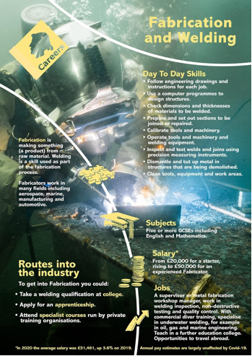
What is Fabrication and Welding
If you’re involved in the metalworking industry, you often hear the terms welding and fabrication. People sometimes use the two terms interchangeably, but there’s a distinct difference between fabrication and welding.
What is the difference between welding and fabrication? The best explanation is that fabrication is the overall process of manufacturing metal, whereas welding is one single part of the fabricating process. You could say that fabrication may include welding, but welding is always a part of fabrication. You can fabricate metal parts without welding but, if you’re welding, you’re definitely fabricating your end product.
There are different skill sets involved in the fabrication process and the welding trade. Both welders and metal fabricators are highly trained craftspeople that often overlap tasks in the overall metal manufacturing industry.
Where can you look for further local training, T levels & apprenticeships
Derby College - Derby College Vocational Engineering
West Notts College - West Notts College Fabrication and Welding
Nottingham College - Nottingham College Engineering
For Apprenticeships – Search College Sites, LinkedIn, Reed or Indeed job sites

Slide 3
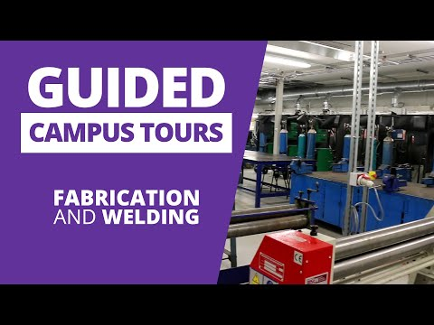
Here's a video from West Notts College and a Guided Tour.
Is this a career or role which you could imagine doing in the future?
West Notts Fabrication and Welding

