Slide 1

Career of the Week

Slide 2
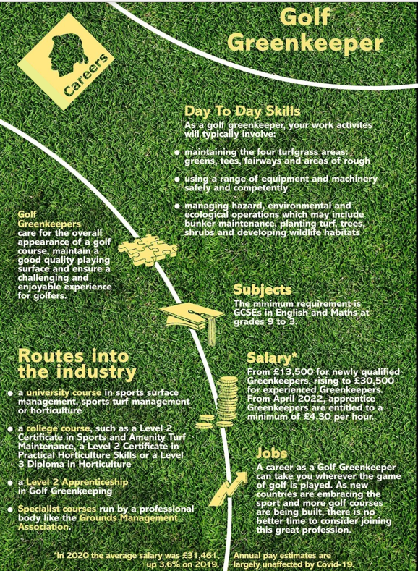

Best Bits of the Job!
Working outside in all weathers and the connection with nature, great for those who love the outdoors and don’t want to be trapped in an office.
Being practical and hands on, from building bunkers, taking care of the fairway and trees, to project planning future courses.
Learning every day, with new technology to help keep the courses in the best condition.
Opportunities to travel the world doing something you love.
Being able to get discounts and play the sport you love.
From a recent job advert, here are some key skills they look for…
Excellent work ethic to provide the highest standards of presentation.
Good communication skills & be able to work as part of a team.
Obviously a passion for golf!

Slide 3
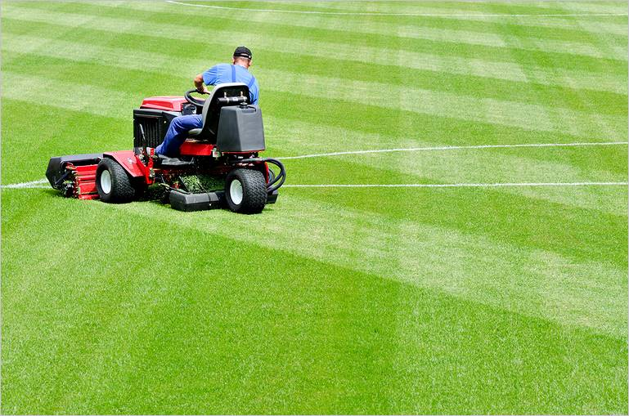
Here's a video on the role of a Greenkeeper
https://www.youtube.com/watch?v=IZs8GE5q9Hg
If you enjoy being outdoors, working with technology, and making a positive impact on golf courses, greenkeeping might just be the best job for you!

