Slide 1

Career of the Week

Slide 2
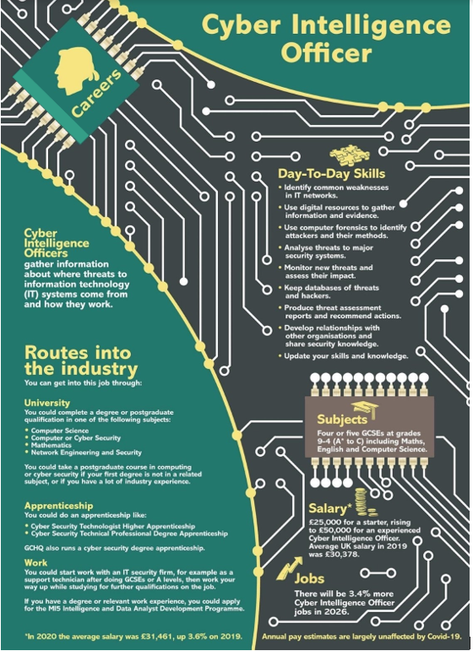

Cybersecurity Stats : Facts & Figures
This is a growing career and industry across all sectors
We access financial information online, shop on retailers’ websites and share personal details on social media accounts.
We increasingly use and rely on digital platforms, we become more exposed to various cybersecurity risks. Malicious hackers exploit security vulnerabilities to capitalize on people’s personal data and organizations’ growing digital footprints.
Threats of financial fraud, unauthorized access and identity theft, cybersecurity has never been more crucial. But what is cybersecurity, exactly? This field encompasses the technology, practices and safety measures used to mitigate and protect against cyber threats, including phishing, malware, ransomware and other types of cyberattacks.
Fast Facts
1) There were 2,365 cyberattacks in 2023 with 343,338,964 victims.¹2023 saw a 72% increase in data breaches since 2021, which held the previous all-time record.
2) Email is the most common vector for malware, with around 35% of malware delivered via email in 2023.³
Hands up have you ever experience any phishing e – mails?
Notes:
Additional facts and figures provided by Forbes website
https://www.forbes.com/advisor/education/it-and-tech/cybersecurity-statistics/

Slide 3
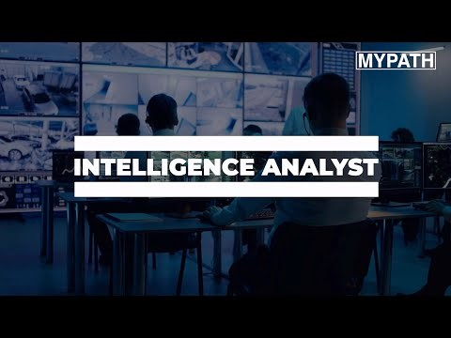
Here's a video on the role of an Intelligence Analyst
Is this a career or role which you could imagine doing in the future?
Add link to video

